Slide 1

Emerging Biotechnologies as Stabilizing Tools for Biological WMD Risk Reduction and Crisis Management
9th Annual SYP Conference
Bartu DORUK
Graduate Researcher | ETH Zürich
20.03.2026

Slide 2

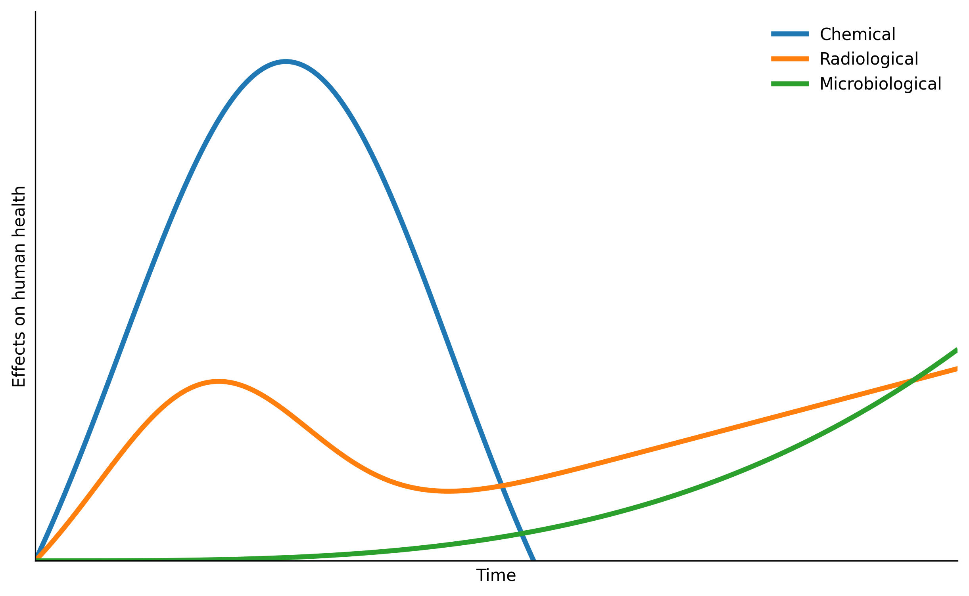
Why Biological Risks Are Different
Delayed detection and invisible spread
Natural vs deliberate ambiguity
Attribution challenges in complex environments
Risk of misinterpretation and escalation in crises
Catastrophic risk

Slide 3


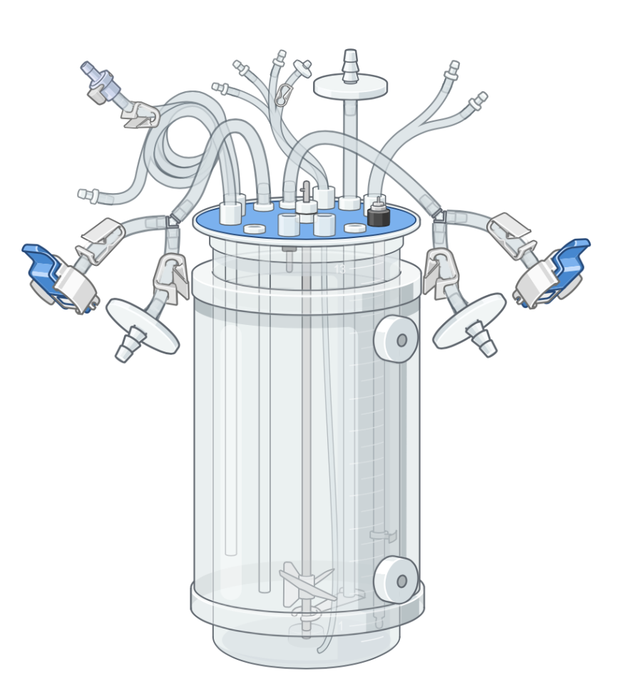
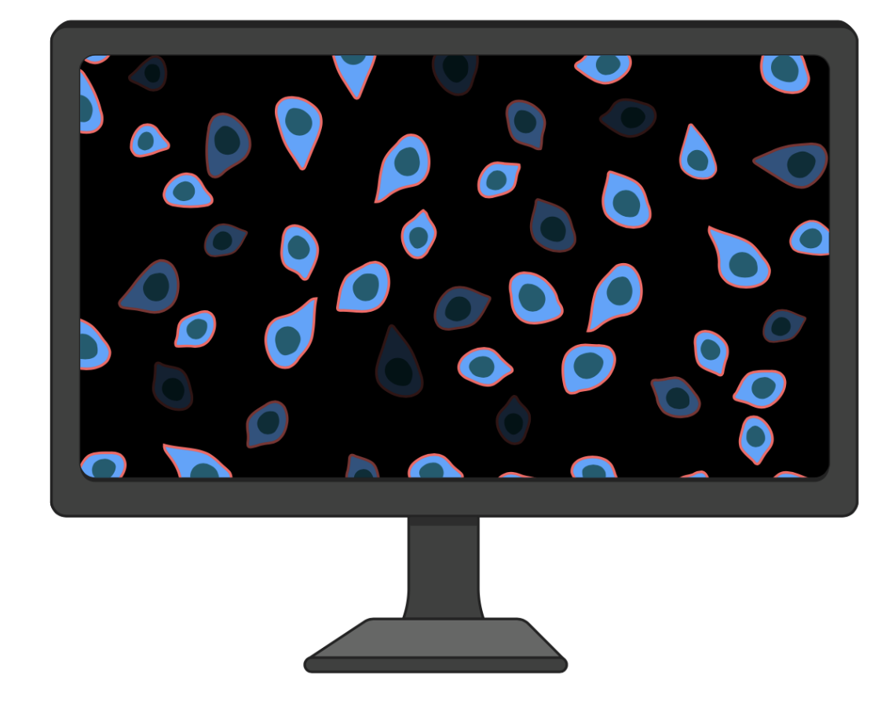
Biotechnology Is Often Viewed as a Security Risk
Lower barriers to biological experimentation
Expanding (synthetic) biology capabilities
Dual-use risks and proliferation concerns

Slide 4
Biotechnologies As Deterrence by Denial
Active Denial
counterproliferation and preventing dual use
Passive Denial
response and recovery
Denying the benefits of covert or deniable actions
Lowering incentive of biological weapon use

Slide 5
Biotechnology Can Also Function as Stabilizing Infrastructure
CBRN Defense
Prevention
Protection
Recovery
Enabled by advances in sensing, biological modeling and platform technologies
Expanding decision space and reducing uncertainty in crises
It can enhance resilience and reduce uncertainty

Slide 6
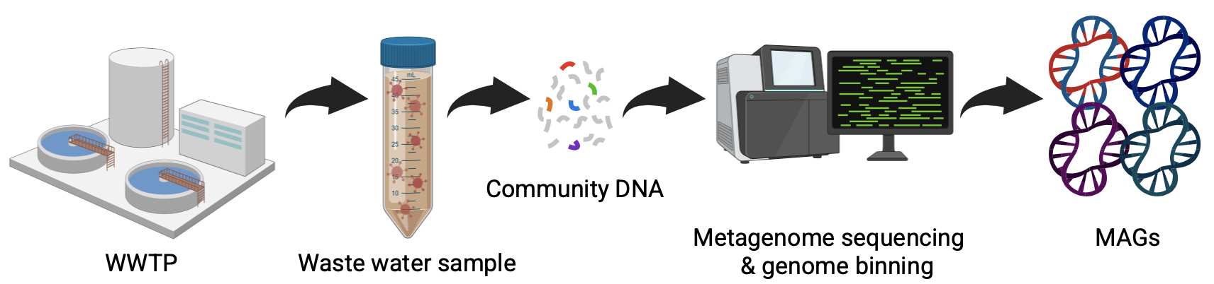
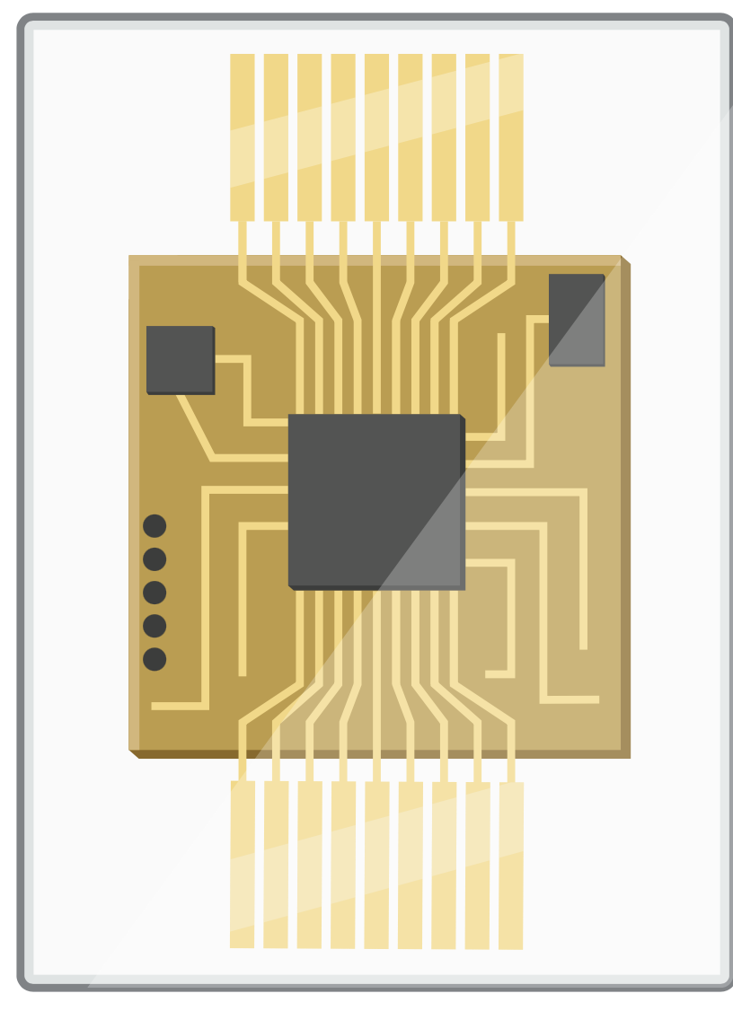
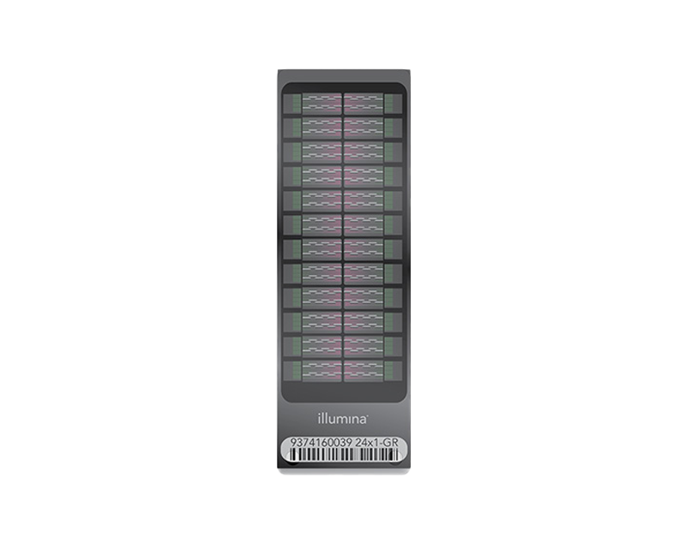
Early Detection Reduces Uncertainty in Biological Crises
Environmental surveillance (e.g. wastewater)
Automated pathogen detection and identification
Portable biosensors
Faster situational awareness
Reduced ambiguity
Notes:
Faster outbreak detection
Earlier situational awareness
Improved identification of threats

Slide 7
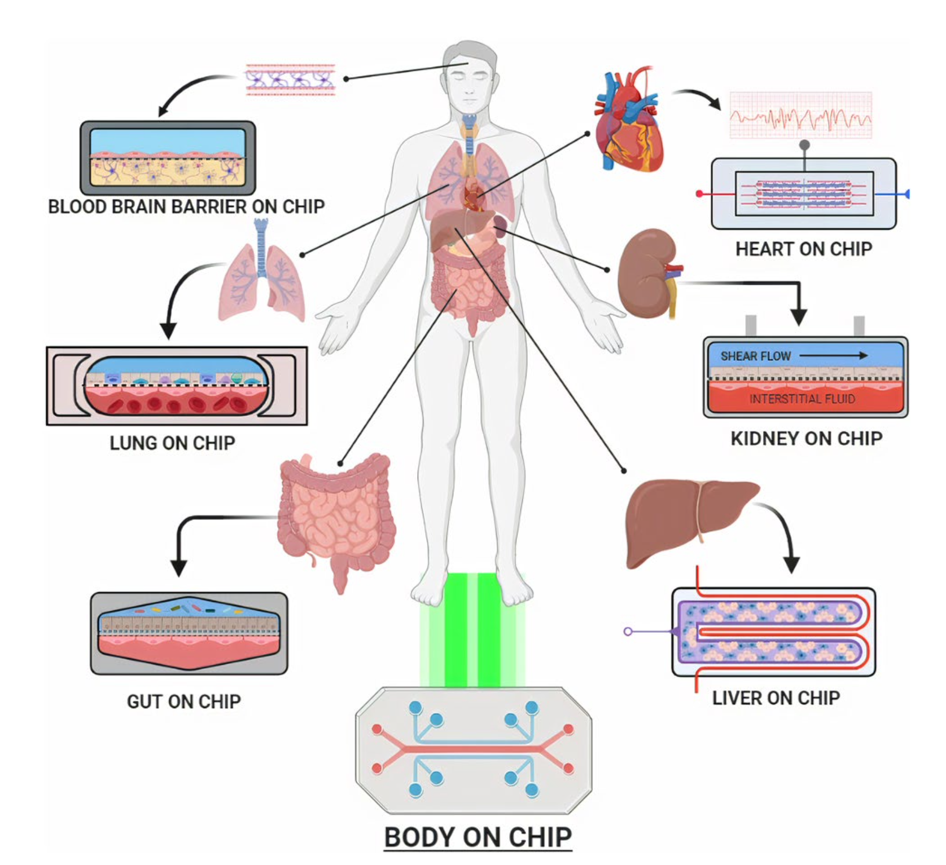
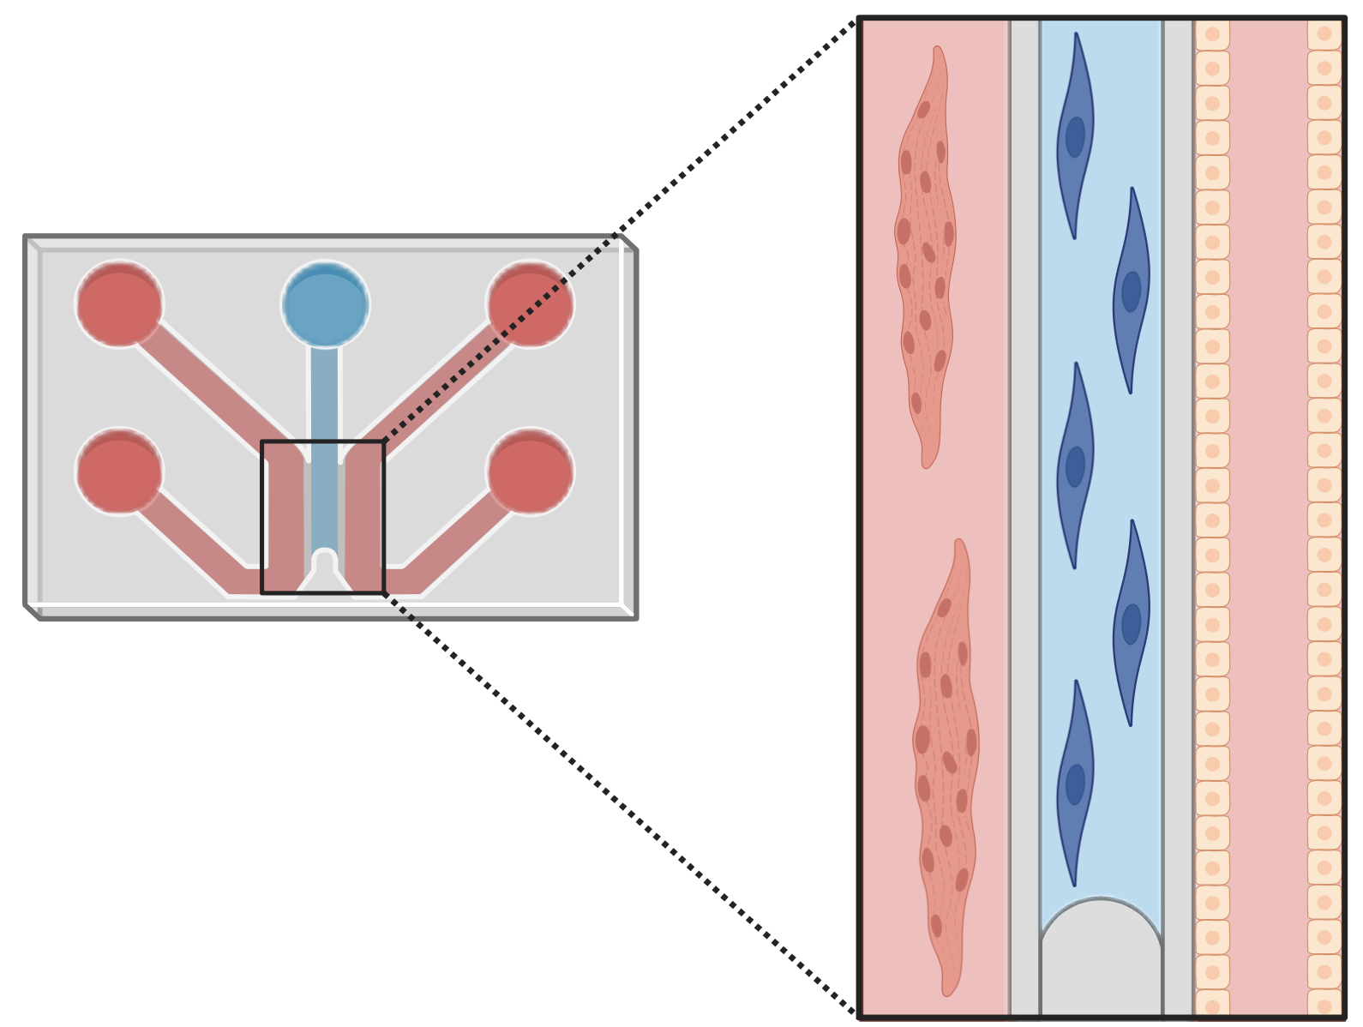
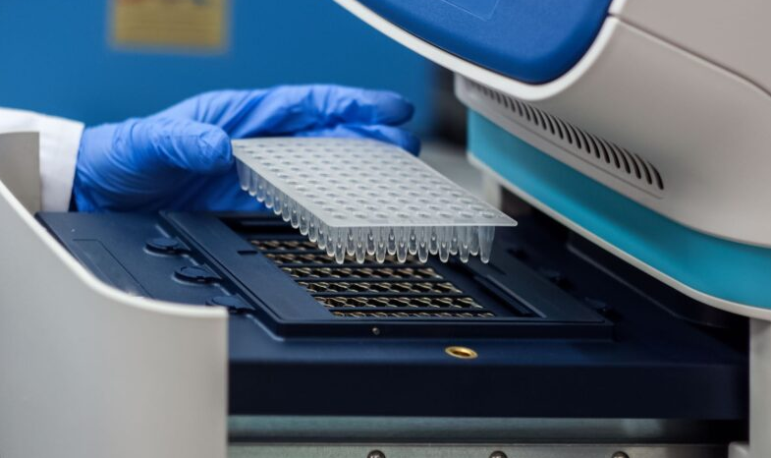
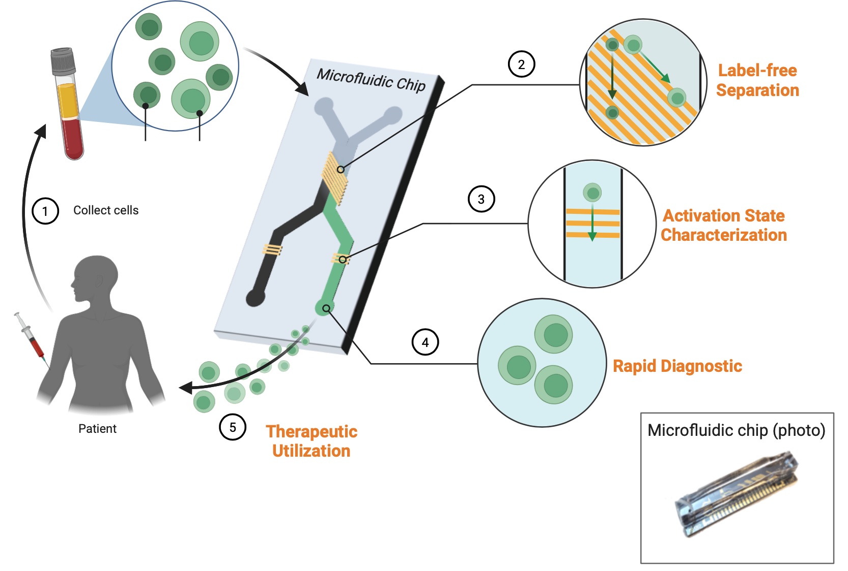
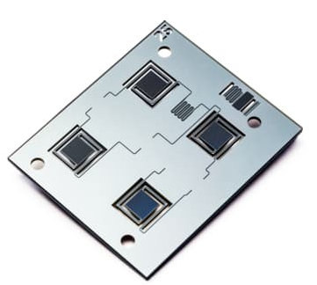
Advanced Biological Modeling Speeds Hazard Assessment
Microphysiological systems (e.g. organ-on-chip)
More reliable evaluation of countermeasures
Assessing exposure to all CBRN agents
https://doi.org/10.1007/s13206-022-00087-8
Notes:
https://www.igenels.com/uses-of-the-pcr-machine/
https://www.imec-int.com/en/expertise/health-technologies/pcr-on-chip

Slide 8
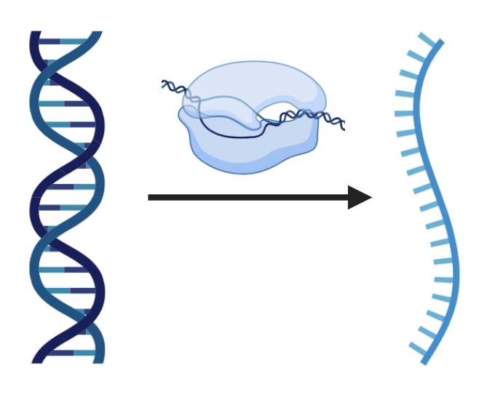
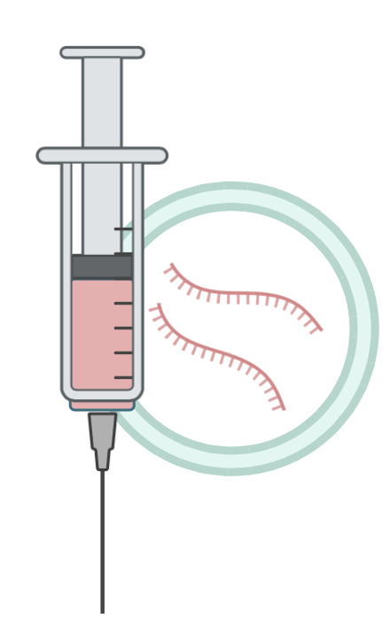

New Platforms Enable Faster Medical Countermeasures
mRNA vaccine platforms
Biologics on demand
Rapid adaptation to novel pathogens

Slide 9
Harnessing Biotechnology for WMD Risk Reduction
Strengthen dual-use governance
Translate fundamental research for biological risk reduction
Engage scientific communities
Invest in preparedness technologies

