Slide 1
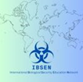
An integrated approach on Chemical, Biological, Radiological and Nuclear Security education: Exploring the challenges arising to CBRN security education from advanced science and technology.
Olivia Ibbotson
Biological Security Research Centre, School of Human Sciences,
London Metropolitan University

Slide 2
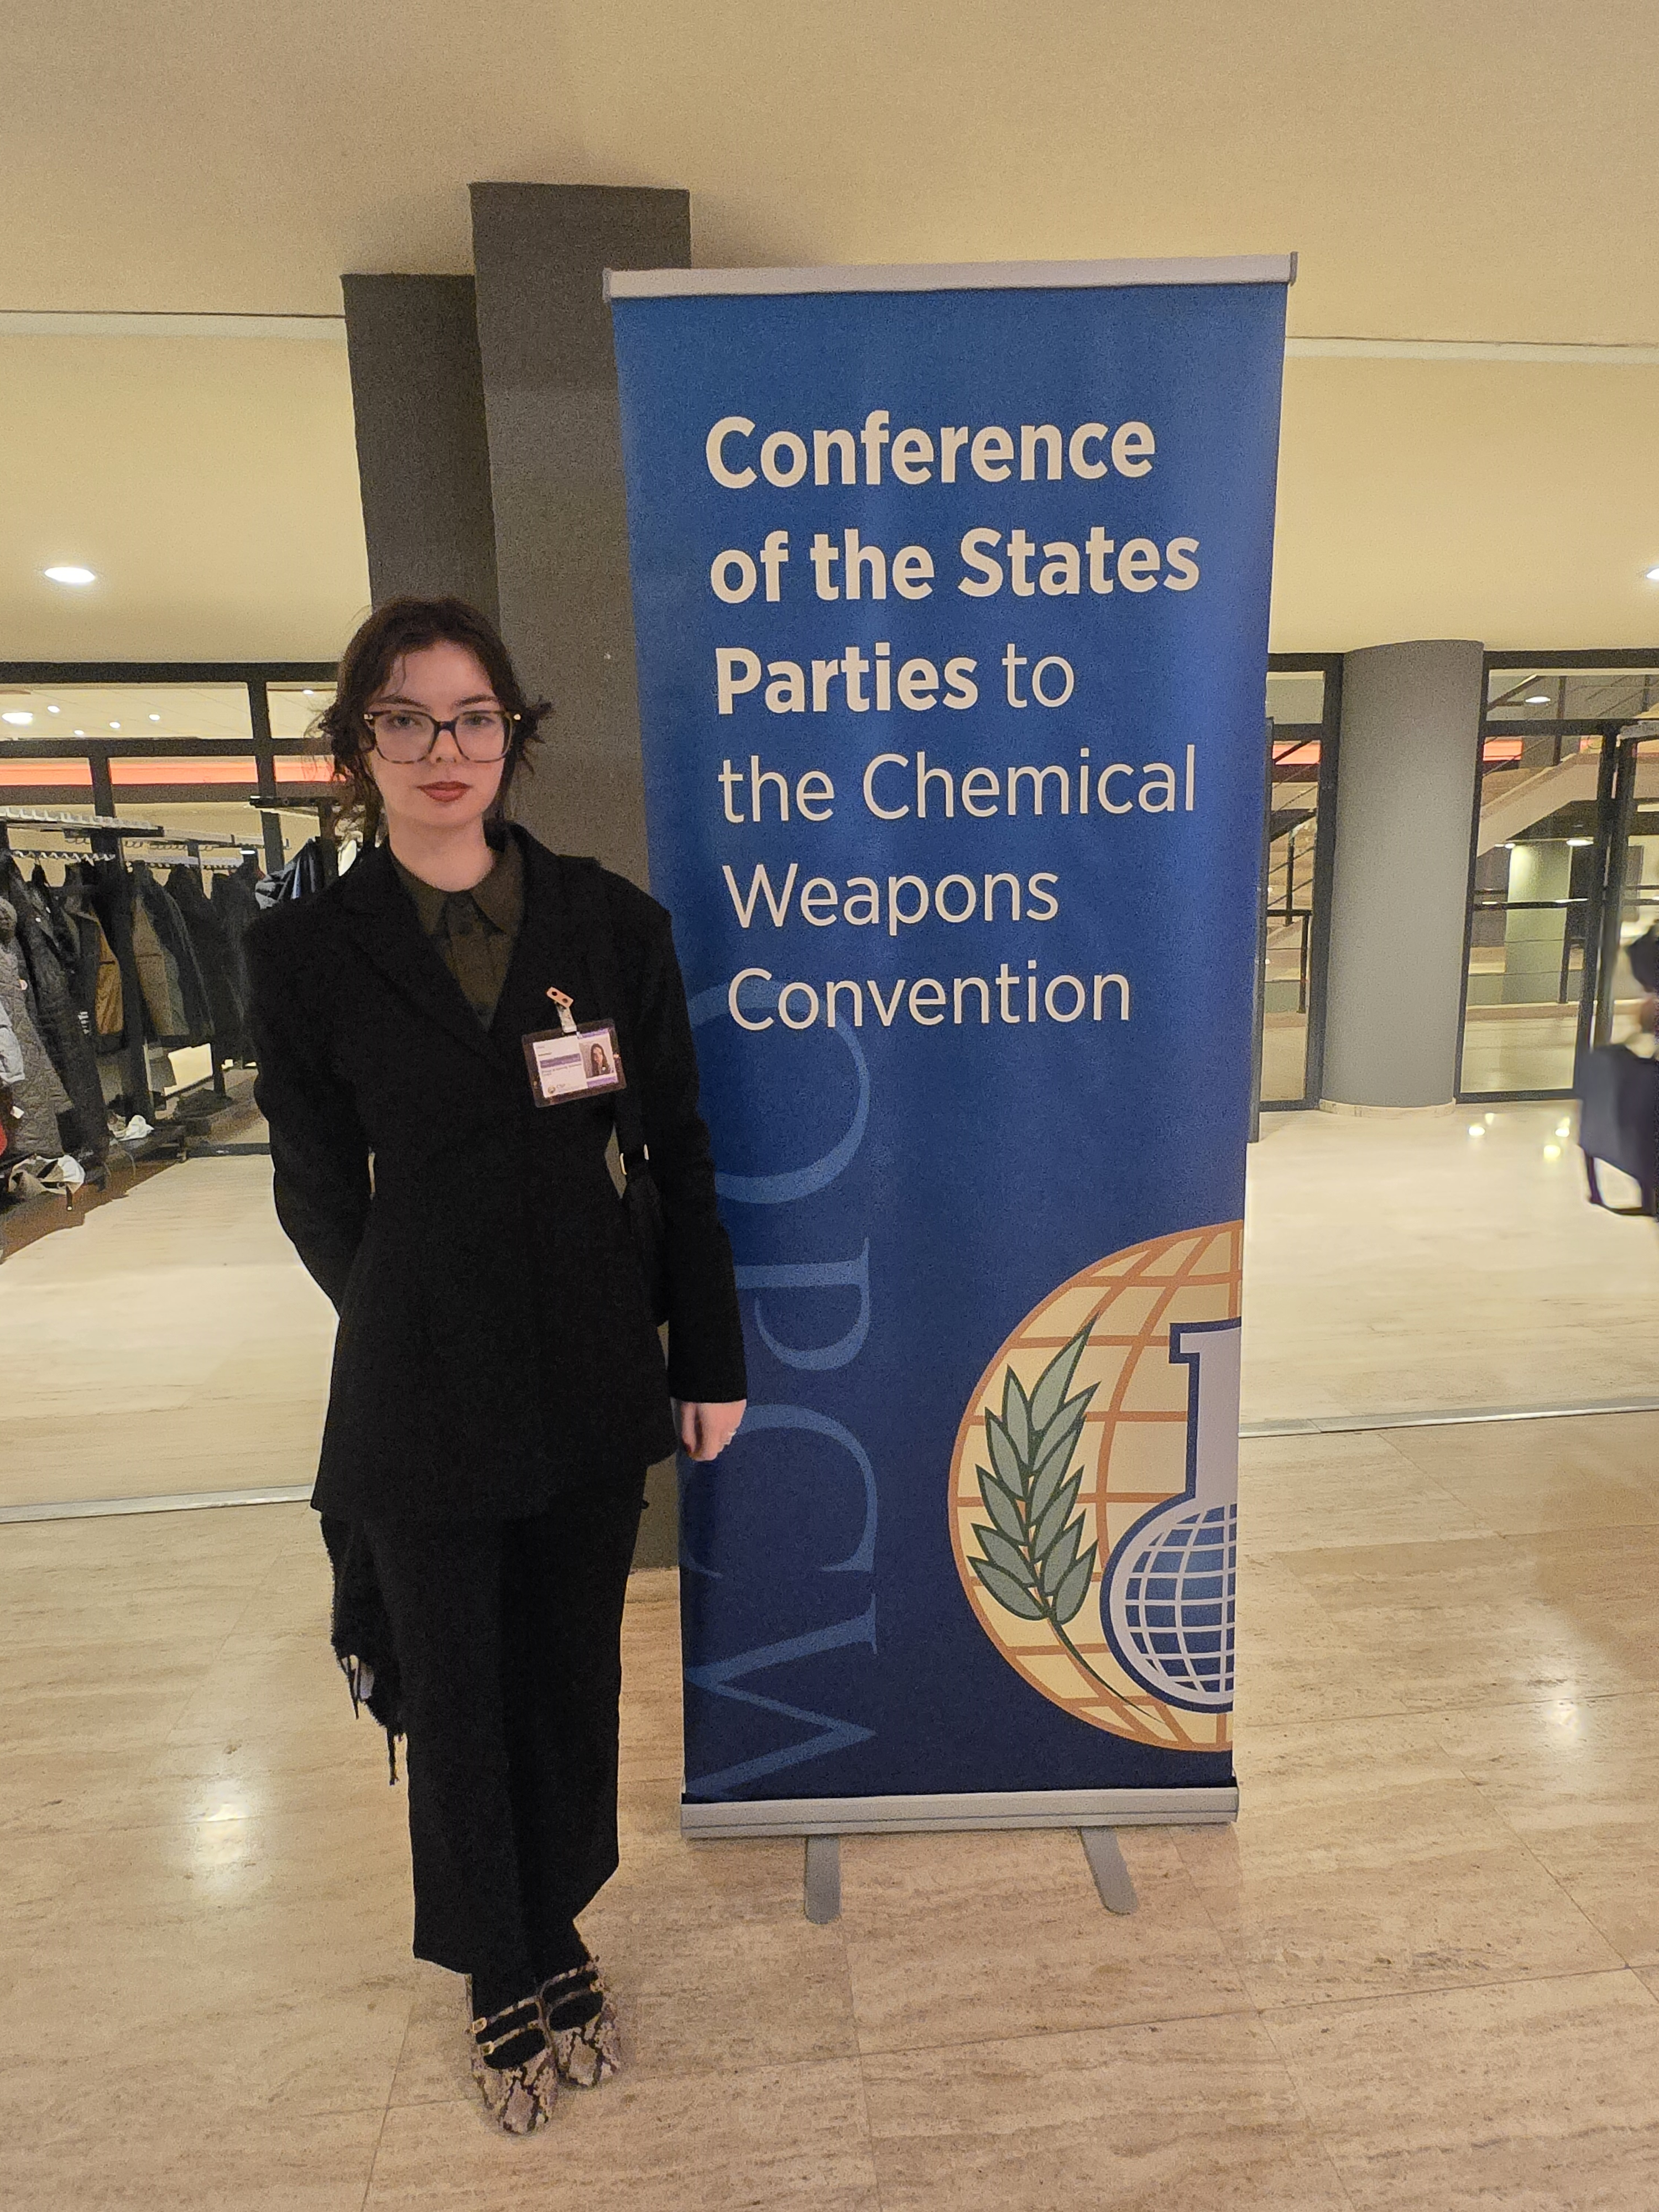
Who am I?
PhD student from the Biological Security Research Centre
International Law of Biological and Chemical weapons focusing on international criminalisation.
Research interests:
Biosecurity education to all levels of academics, policy makers etc
Legality and ethics of White phosphorus use by the military
AI risks to biosecurity
o.ibbotson@londonmet.ac.uk
oli0129@my.londonmet.ac.uk

Slide 3
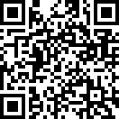
Biological Security Research Centre (BSRC)
Who are we?
What is our centre's objective?
What is the context of our centre?

Slide 4
Arising challenges to CBRN security education:
The Fourth Industrial Revolution
Rapid advancements in Science & Technology:
Artificial Intelligence, Nanomaterials, synthesised biology etc
Ethical challenges:
Dual-Use Research of Concern, Information Hazards and risk/benefit analysis of open-source research.

Slide 5
The emergence of ChatGPT by Open AI in 2022
Biological Security:
Large Language Models and Biological Design tools could potentially be used to facilitate the development of a Biological Weapon.
There is equal concern on the impact of these AI technologies on nuclear security and weapons.

Slide 6
Deepseek AI – Open-source LLM
Open-source Large Language Model
Open source leaves the AI vulnerable to infiltration by malicious actors, release of sensitive information and the potential to input information hazards.
Implementation of open-source AI further highlights risks facing CBRN security and draws questions as to how to establish adequate training and education.

Slide 7
The role of civil society
Before we can fully understand the impact of these technologies and establish adequate governance, civil society must play the leading role to raise awareness and carry out education.

Slide 8
Lessons for biosecurity education from the International Nuclear Security Network.
Iris Magne, Olivia Ibbotson, Lijun Shang, Malcolm Dando. 2024, Journal of Biosafety and Biosecurity 6, 252-257. https://doi.org/10/1016/job.2024.09.002
Closing the Biological Security Education Gap: The Essential Elements.
Lijun Shang, Weiwen Zhang, Malcolm Dando. Journal of Strategic Trade Control, 2024
Rethinking biological security education to strengthen the Biological and Toxin Weapons Convention.
Lijun Shang, Malcolm Dando. Intersec (the Journal of International Security). 2024 Jan 4. November/Decmber 2023
Dual-use Oversight: Is the Scientific Community Fit for Purpose? What should be done if it is not?
Lijun Shang, Kathryn Millett, Malcolm Dando. Journal of Biosafety and Biosecurity. 2023. 5(4): 153-154, DOI: 10.1016/j.job.2023.11.001
Rethinking Biosecurity After the Pandemic: An Enhanced Role for Civil Society.
Lijun Shang, Malcolm Dando. 2023, Journal of Biosafety and Biosecurity. 2023, 5(3): 100-106, doi.org.10.1016/j.job.2023.07.004
A Key role of scientists in strengthening the Biological Weapons Convention.
Lijun Shang, Lincoln Sheff, Malcolm Dando. 2023, Front. Polit. Sci. 5: 1265008. doi:10.3389/fpos.2023.1265008

Slide 9
An investigation into the legality of White Phosphorus uses in the military and the consequences to humans and the environment: Should White Phosphorus be classed as an inhumane weapon of war?
Olivia Ibbotson, Biological Security Research Centre , London Metropolitan University
The urgent need for Biosecurity education at Universities within the Agribusiness Sector
Olivia Ibbotson and Lijun Shang, Biological Security Research Centre , London Metropolitan University
An overview of Biosecurity risks posing threat to the Agribusiness sector in the 21st Century
Olivia Ibbotson and Lijun Shang, Biological Security Research Centre , London Metropolitan University

Slide 10
How do we address these concerns?
Education and training of academics, professionals and policy makers
The field of CBRN security are ALL facing risks in parallel regarding advanced S&T, particularly when combined with AI.
Thus, we MUST form an integrated approach to teaching advanced S&T risks to CBRN security.

Slide 11
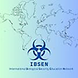
International Biological Security Education Network (IBSEN)
Project funded by the Joseph Rowntree Charitable Trust (JRCT)
Based on principles of the 1925 Geneva Convention, BTWC and CWC.
Aims to lay the foundations of a framework for widespread biosecurity education and advocates for an integrated approach to addressing risks to CBRN security education
The IBSEN’S project is advised and reviewed by an International Oversight Board, including eight members representing a broad geographic coverage.

Slide 12
Acknowledgements
Joesph Rowntree Charitable Trust
The British Academy
Marmot Trust
Research England
London Metropolitan Univeristiy

Slide 13
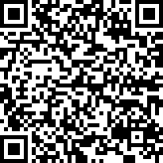
Website links
BSRC
IBSEN
LinkedIn

