Slide 1
Regional Instability and Proliferation Risks: A Focus on South Asia
Name: Muhammad Qasim
Affiliation: Nuclear Information Service

Slide 2
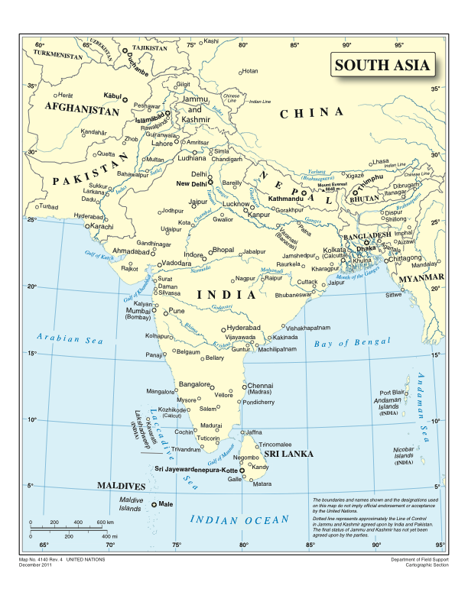

Slide 3
Why South Asia?
A unique region with three nuclear-armed states: India, Pakistan, and China.
High population density and economic interdependence.
Gateway between the Middle East, Central Asia, and Southeast Asia.
History of conflicts and border tensions.

Slide 4
Why is there Regional Instability?
Unresolved territorial disputes (Kashmir etc.)
Cross-border militancy and insurgencies.
Political volatility and weak regional cooperation.
Influence of major powers and shifting alliances.

Slide 5
Why are there Proliferation Risks?
Expanding nuclear arsenals (India & Pakistan both increasing stockpiles).
Development of new missile systems (Hypersonic, MIRVs, Cruise Missiles).
Risk of accidental escalation or miscalculation.
Emerging threats: Tactical nuclear weapons and non-state actors.

Slide 9
What is the Way Forward?
Strengthening diplomatic engagement and confidence-building measures.
Arms control agreements and nuclear risk reduction centers.
Promoting economic and regional cooperation (SAARC, trade ties, etc.).
Enhancing crisis communication between nuclear powers.

