Slide 1
What a future regulation on autonomous weapons systems can learn from the nuclear regime
Veerle Moyson, 27 January 2024
7th Annual SYP Conference: ‘AI, Peace and Security’

Slide 2
Outline
Personal capacity
Defining the concepts
Evaluating AWS
Moving forward
Lessons from nuclear
Conclusions
Veerle Moyson
Image: LeoNeoBoy from Pixabay

Slide 3
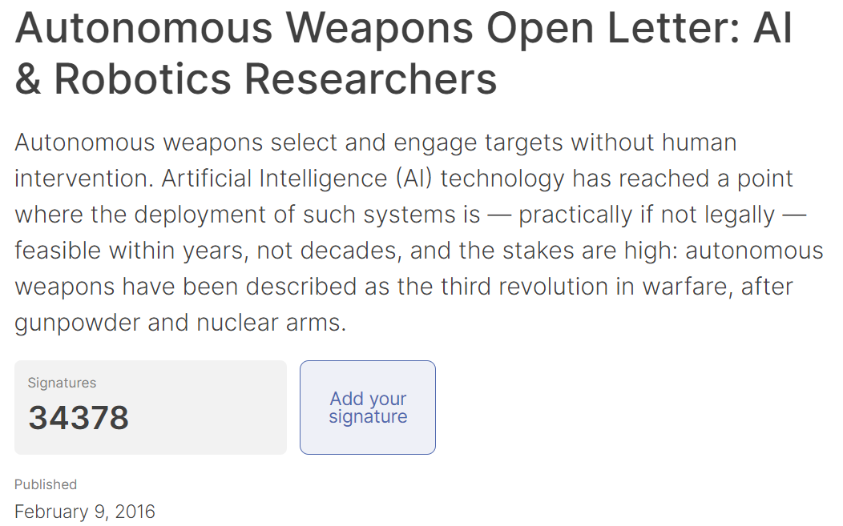
Outline
Defining the concepts
Evaluating AWS
Can they?
Should they?
Strategic considerations
Moving forward
Lessons from nuclear
History
NPT
TPNW
Conclusions
Veerle Moyson
Image: Future of Life Institute

Slide 4
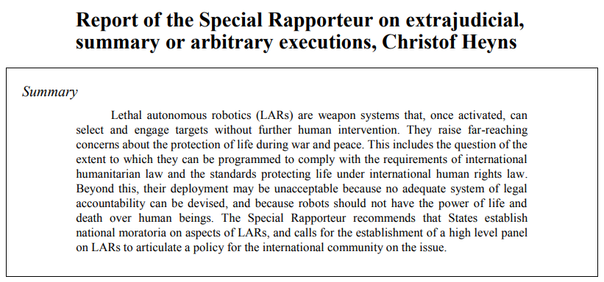
Outline
AWS
Autonomy levels
Use of (lethal) force
AI
Enabler
Seemingly endless applications
Defining the concepts
Evaluating AWS
Can they?
Should they?
Strategic considerations
Moving forward
Lessons from nuclear
History
NPT
TPNW
Conclusions
Veerle Moyson
Image: UNGA A/HRC/23/47

Slide 5
Outline
Can AWS comply with international law?
Technological limitations
Human-machine interactions
Defining the concepts
Evaluating AWS
Can they?
Should they?
Strategic considerations
Moving forward
Lessons from nuclear
History
NPT
TPNW
Conclusions
Veerle Moyson
Image: Freepik
Notes:
Can
IHL
Tech limitations
Human-machine interactions
Should
Humanity and ethics
Responsibility gap
Strategic implications
Lower threshold – continuing wars
Unintended escalation
No responsible players

Slide 6
Outline
Should weapons have the capacity to initiate lethal force?
Humanity and ethics
Responsibility gap
Defining the concepts
Evaluating AWS
Can they?
Should they?
Strategic considerations
Moving forward
Lessons from nuclear
History
NPT
TPNW
Conclusions
Veerle Moyson
Image: Freepik
Notes:
Can
IHL
Tech limitations
Human-machine interactions
Should
Humanity and ethics
Responsibility gap
Strategic implications
Lower threshold – continuing wars
Unintended escalation
No responsible players

Slide 7
Outline
Strategic implications
Threshold to war
Unpredictability
Defining the concepts
Evaluating AWS
Can they?
Should they?
Strategic considerations
Moving forward
Lessons from nuclear
History
NPT
TPNW
Conclusions
Veerle Moyson
Image: jcomp on Freepik
Notes:
Can
IHL
Tech limitations
Human-machine interactions
Should
Humanity and ethics
Responsibility gap
Strategic implications
Lower threshold – continuing wars
Unintended escalation
No responsible players

Slide 8
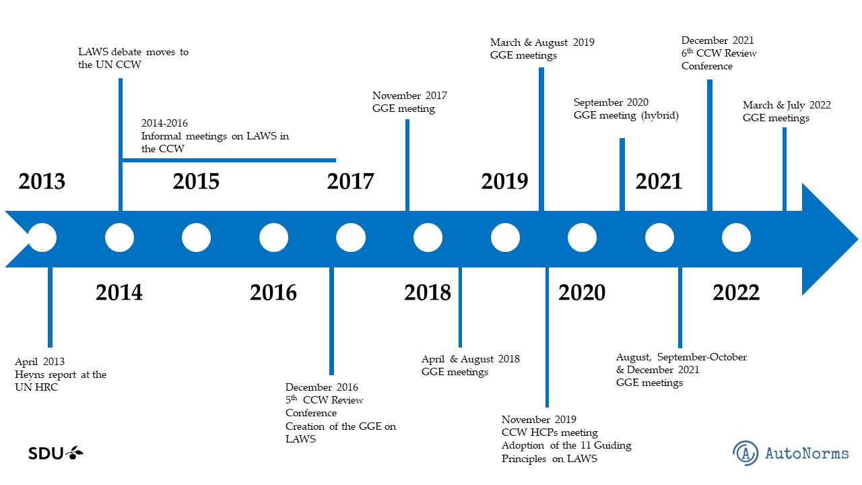
Outline
Status?
Convergence
11 guiding principles
Slow progress still
Binding regulation
Defining the concepts
Evaluating AWS
Can they?
Should they?
Strategic considerations
Moving forward
Lessons from nuclear
History
NPT
TPNW
Conclusions
Veerle Moyson
Image: Anna Nadibaidze on Autonorms.eu

Slide 9
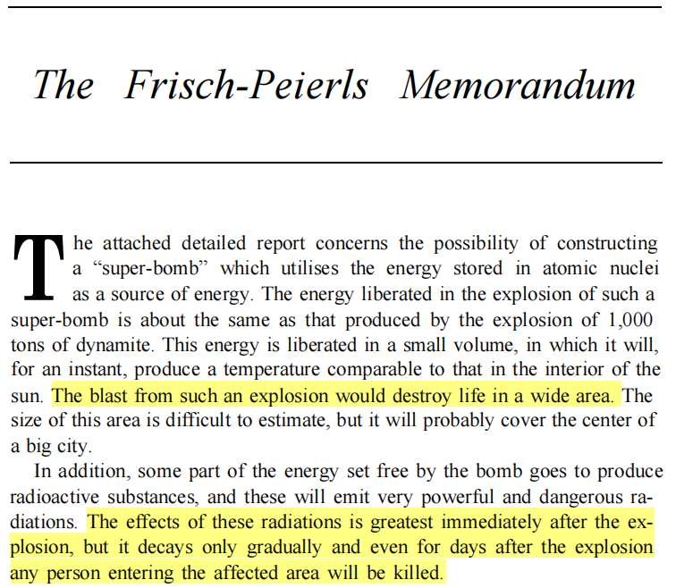
Outline
Why nuclear
History
Waiting for disaster
Norm-building
Defining the concepts
Evaluating AWS
Can they?
Should they?
Strategic considerations
Moving forward
Lessons from nuclear
History
NPT
TPNW
Conclusions
Veerle Moyson
Image: Frisch-Peierls Memorandum
Notes:
Why nuclear
Long history
History
Early warning of scientists
Waiting until disaster
Development of norm
The NPT
Universality
Trade-off with security assurances
Peaceful purposes assured
Resentment, bitterness, and disappointment: imbalance
TPNW
Human-centered
Grassroots
Re-invigorated push for disarmament

Slide 10
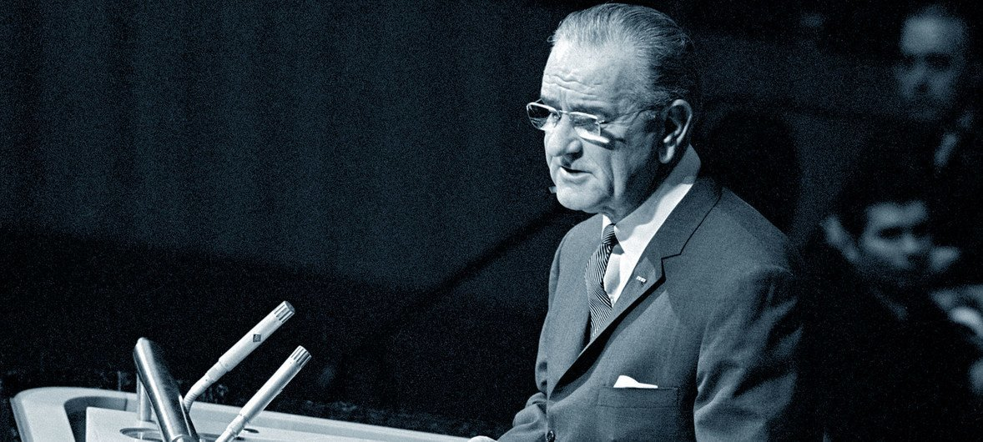
Outline
Non-Proliferation Treaty
Successful
Peaceful purposes
Non-democratic
Disarmament
Defining the concepts
Evaluating AWS
Can they?
Should they?
Strategic considerations
Moving forward
Lessons from nuclear
History
NPT
TPNW
Conclusions
US President Johnson addresses the UN General Assembly in June 1968 after it adopted a resolution on the Non-Proliferation of Nuclear Weapons.
Veerle Moyson
Image: UN Photo by Yutaka Nagata on news.un.org
Notes:
Why nuclear
Long history
History
Early warning of scientists
Waiting until disaster
Development of norm
The NPT
Universality
Trade-off with security assurances
Peaceful purposes assured
Resentment, bitterness, and disappointment: imbalance
TPNW
Human-centered
Grassroots
Re-invigorated push for disarmament

Slide 11
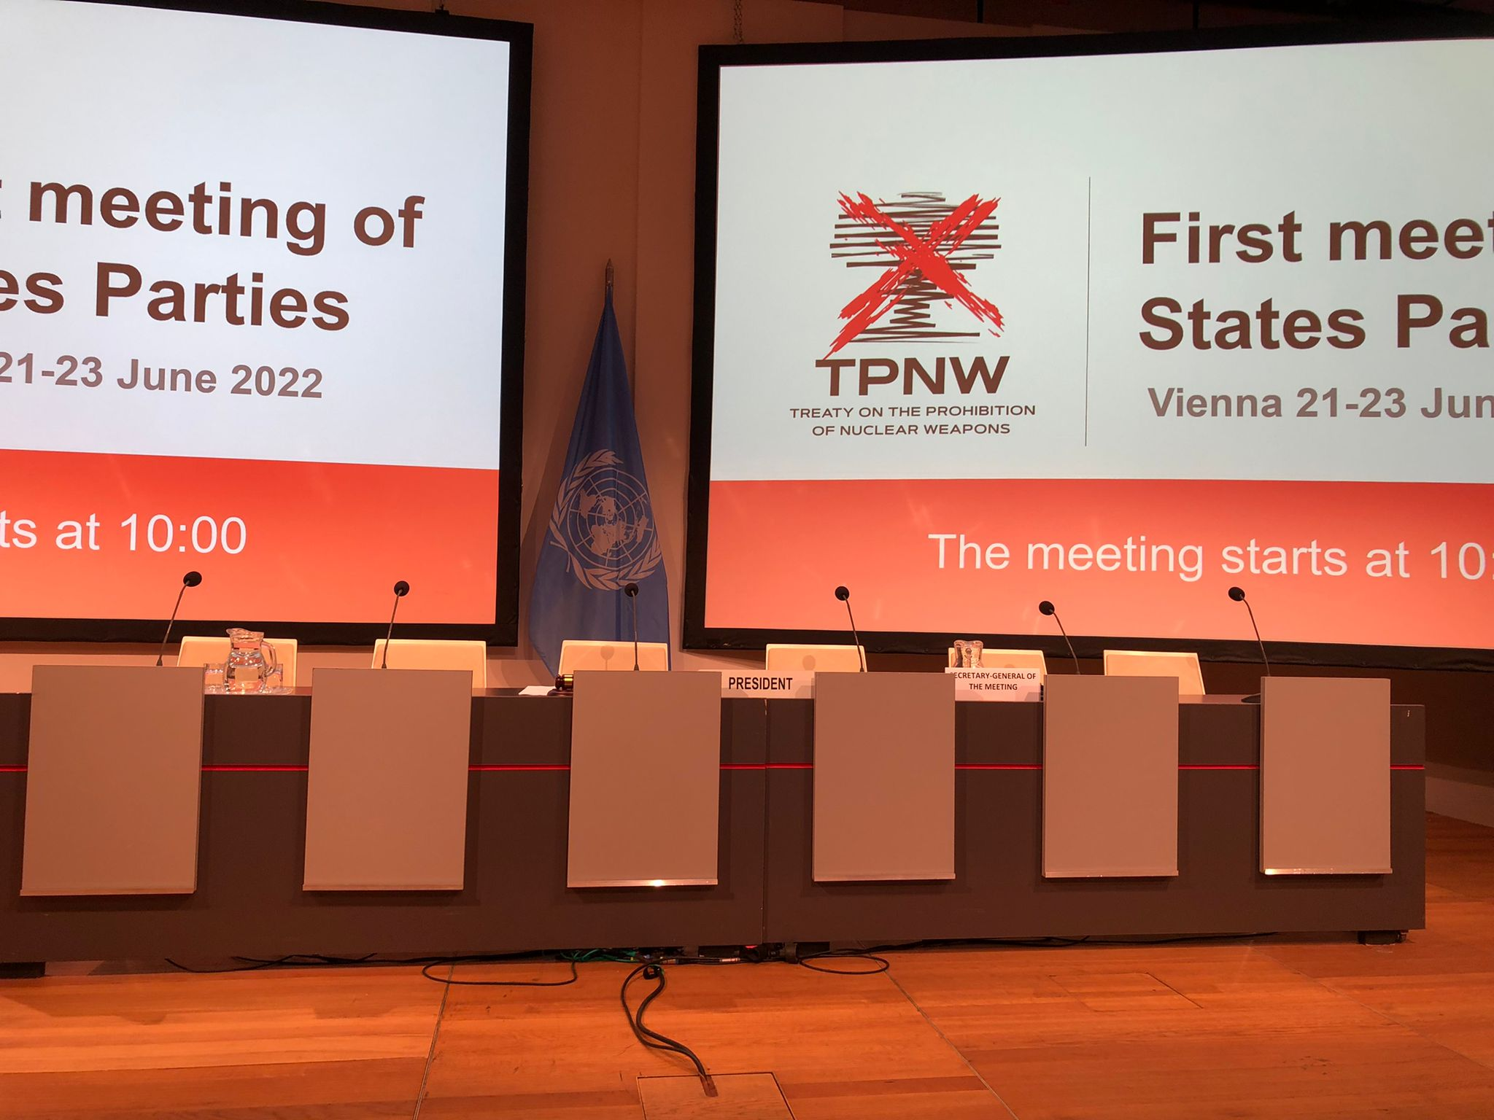
Outline
Treaty on the Prohibition of Nuclear Weapons
Humanitarian approach
Lack of universality
Defining the concepts
Evaluating AWS
Can they?
Should they?
Strategic considerations
Moving forward
Lessons from nuclear
History
NPT
TPNW
Conclusions
Veerle Moyson
Notes:
Why nuclear
Long history
History
Early warning of scientists
Waiting until disaster
Development of norm
The NPT
Universality
Trade-off with security assurances
Peaceful purposes assured
Resentment, bitterness, and disappointment: imbalance
TPNW
Human-centered
Grassroots
Re-invigorated push for disarmament

Slide 12
Outline
Conclusions
Listen to warnings
Equality of states
Peaceful uses
Humanitarian perspective
Compromise or universality
Long-term sustainability
Defining the concepts
Evaluating AWS
Can they?
Should they?
Strategic considerations
Moving forward
Lessons from nuclear
History
NPT
TPNW
Conclusions
Veerle Moyson
Image: Willi Heidelbach from Pixabay
Notes:
Why nuclear
Long history
History
Early warning of scientists
Waiting until disaster
Development of norm
The NPT
Universality
Trade-off with security assurances
Peaceful purposes assured
Resentment, bitterness, and disappointment: imbalance
TPNW
Human-centered
Grassroots
Re-invigorated push for disarmament

Slide 13
Thank you
Any questions?
Veerle Moyson

