Slide 1
Just because you can, doesn’t mean you should
Rachel Coldicutt

Slide 2
Hello!
I’m Rachel Coldicutt
I run a research and prototyping studio called Careful Trouble

Slide 3
Our work understands the social impacts of technologies and shows alternatives -
and we think that AI should work for 8 billion people, not 8 billionaires

Slide 4
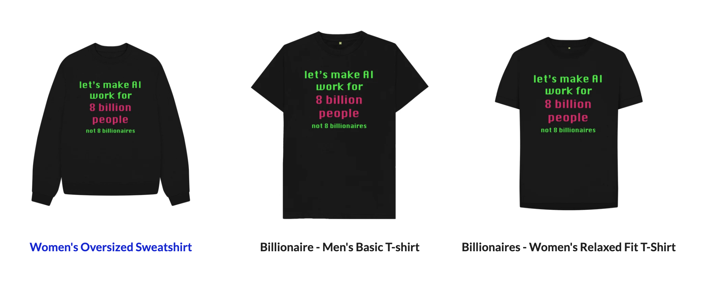
carefulindustries.teemill.com/billionaires

Slide 6
How to regulate AI in a time of global uncertainty?

Slide 7
A challenge for the whole of society: for communities and activists, workers, corporate boards, as well as for legislators and politicans

Slide 9
What does “AI ethics” mean anyway?

Slide 10
“AI ethics” is a simultaneously complex and overgeneralising term

Slide 11
AI refers to many disparate technologies and their uses

Slide 13
Ethics are not universal but can be subjective and contextual

Slide 14
Is it possible for general purpose AI to do no harm?

Slide 15
What is general purpose AI?

Slide 16
“​​AI systems that have a wide range of possible uses, both intended and unintended by the developers. They can be applied to many different tasks in various fields, often without substantial modification and fine-tuning.”
EU AI Act

Slide 17
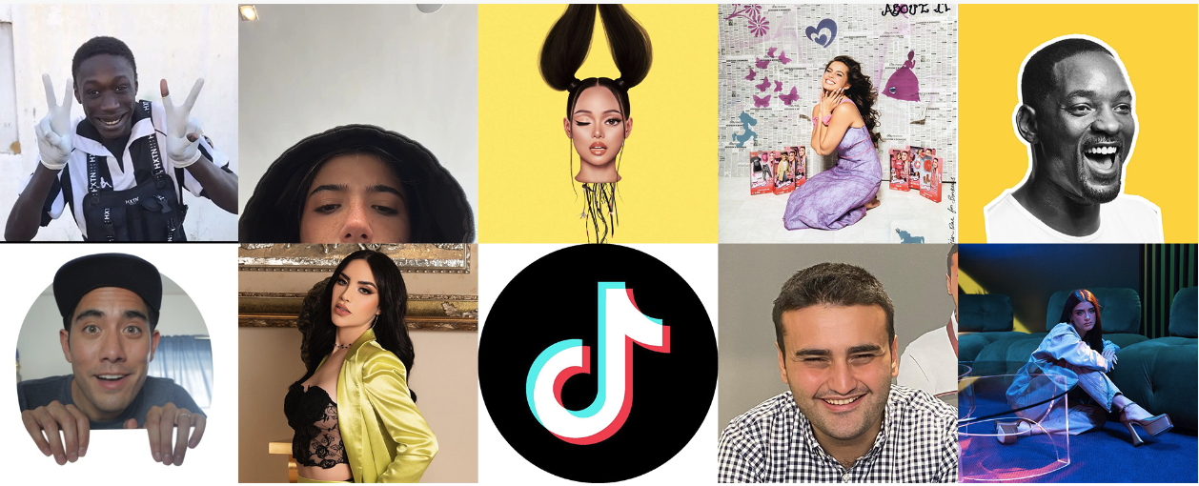
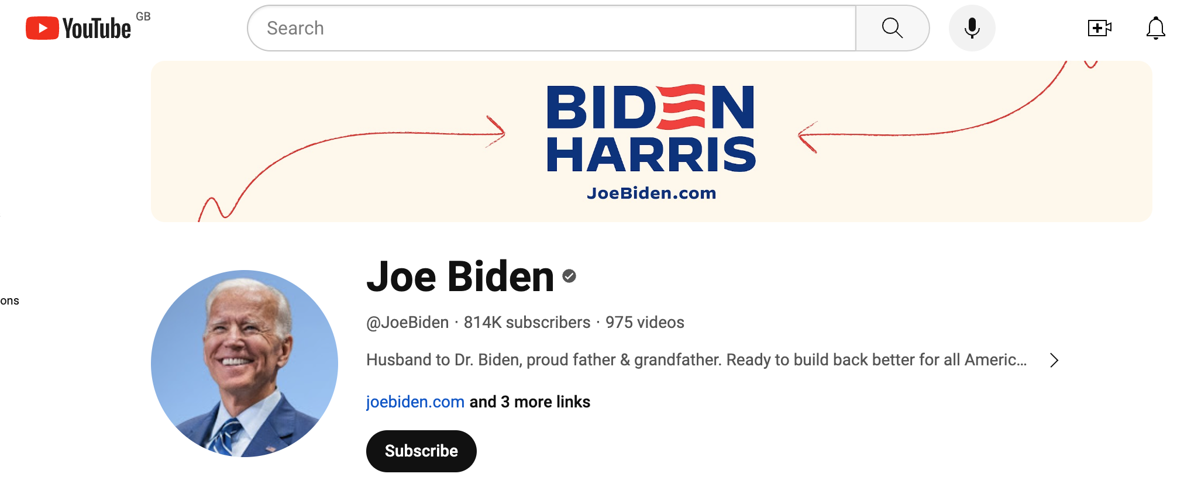

Slide 18
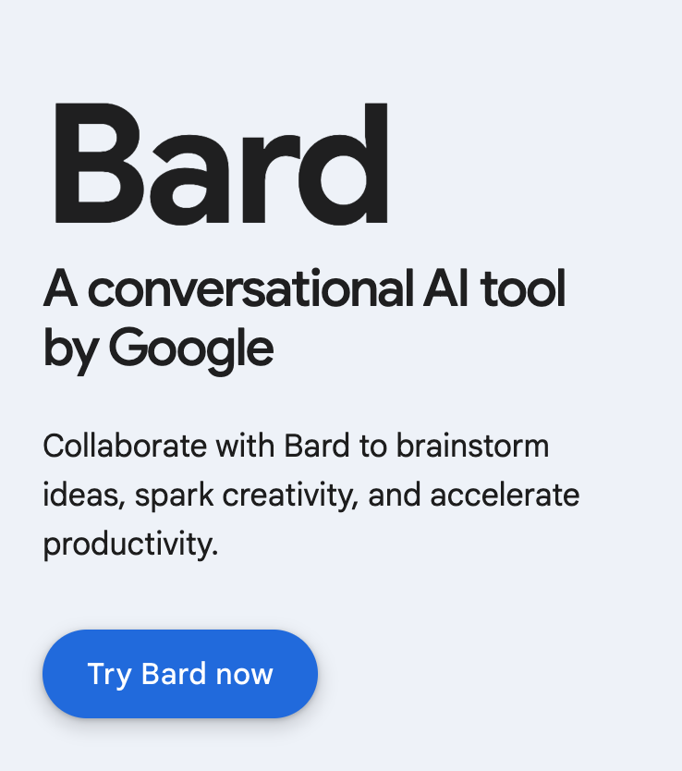
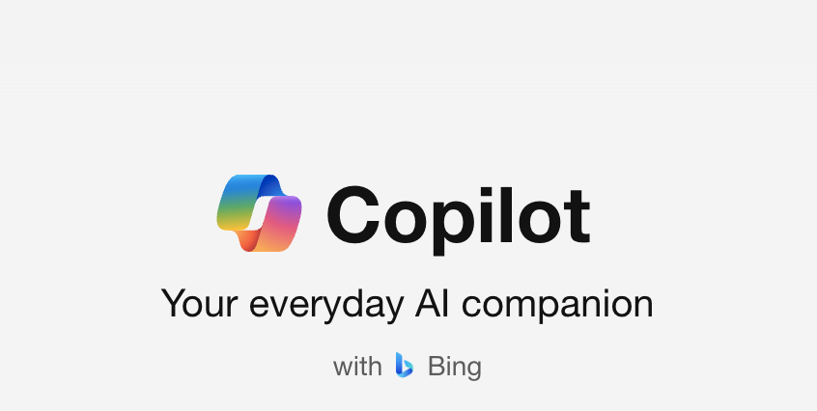
General purpose tools designed to learn and grow depending on how they are used

Slide 20
Context

Slide 21
“the transition into a multipolar, fragmented and contested world has happened more quickly and definitively than anticipated. We are now in a period of heightened risk and volatility that is likely to last beyond the 2030s.”
UK Govt, Integrated Review Refresh (2023)

Slide 22
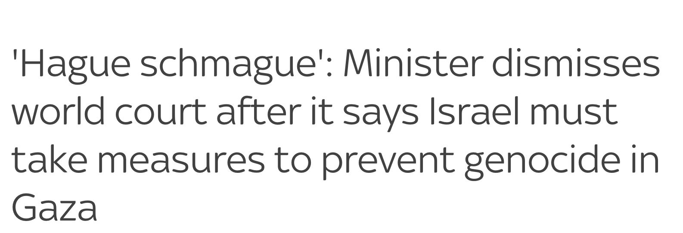

Slide 23
Technology adaptation and development

Slide 24
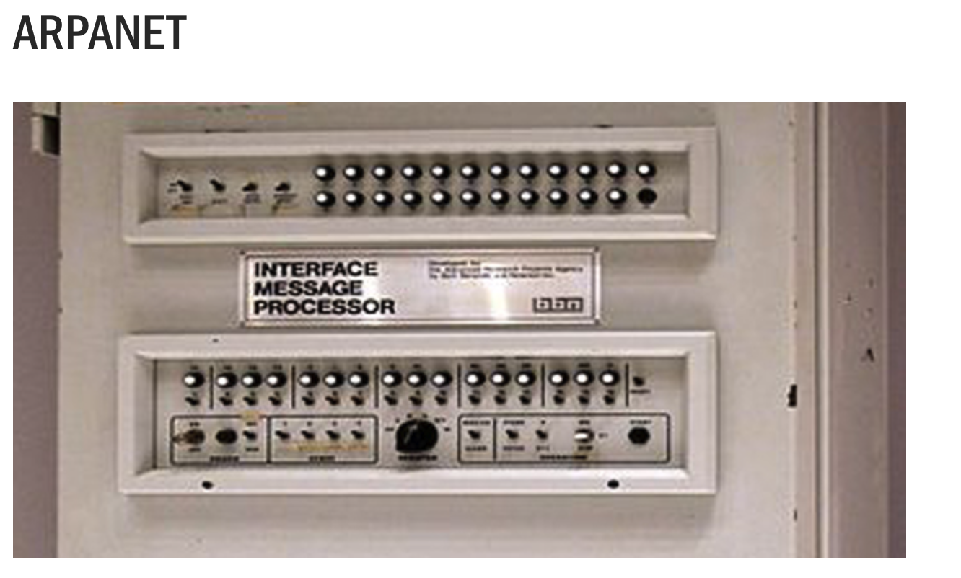
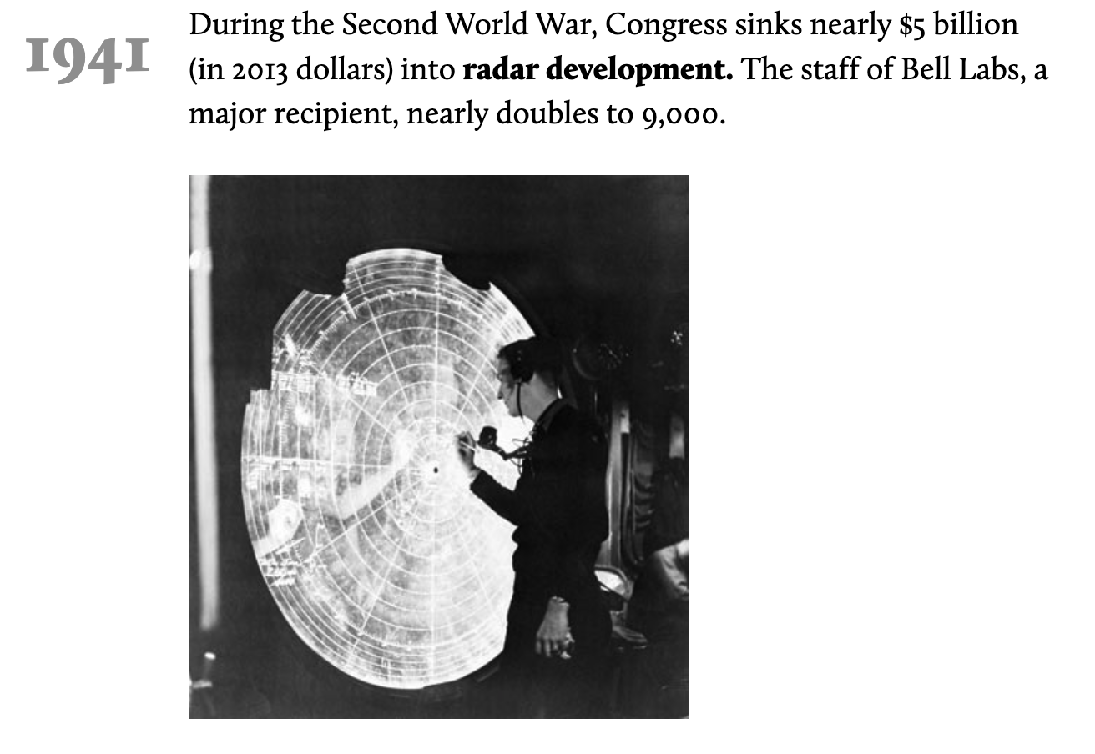

Slide 25
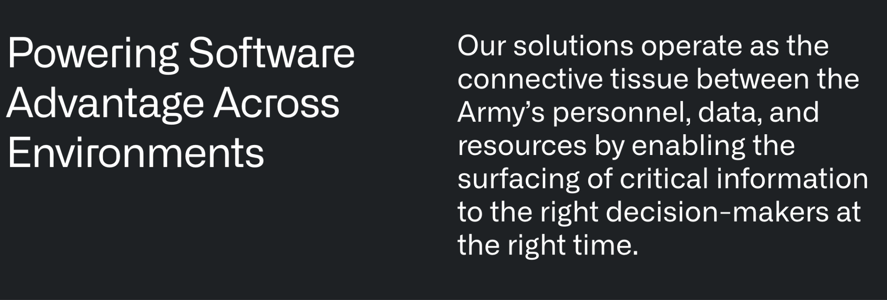

Slide 26
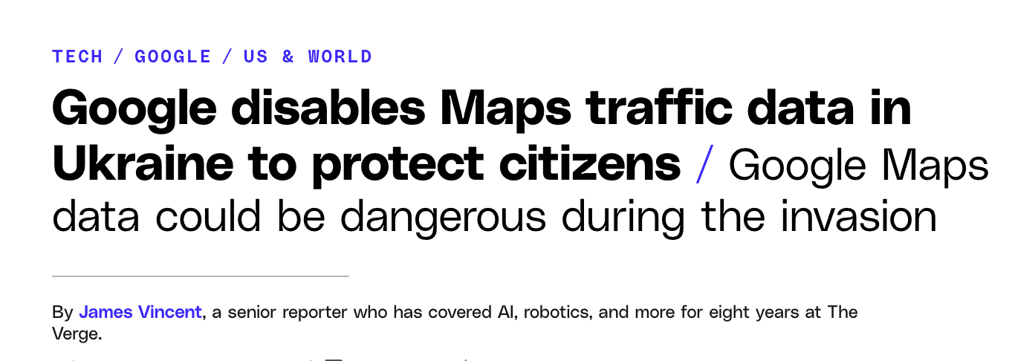
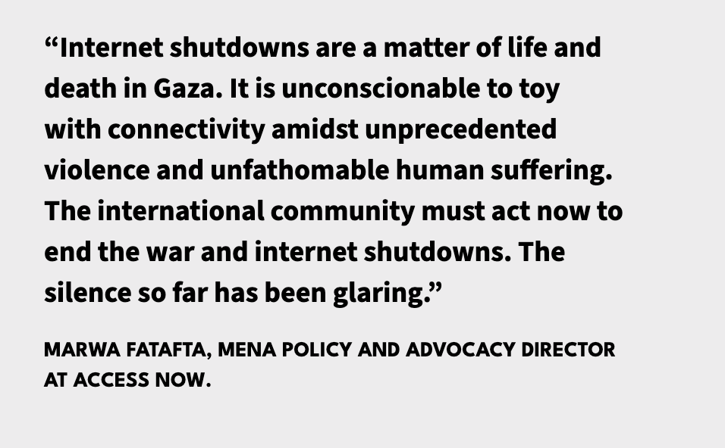
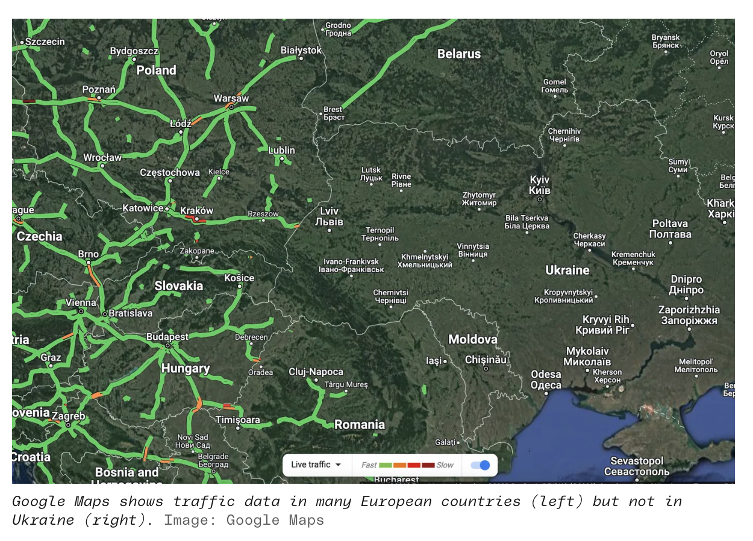

Slide 27
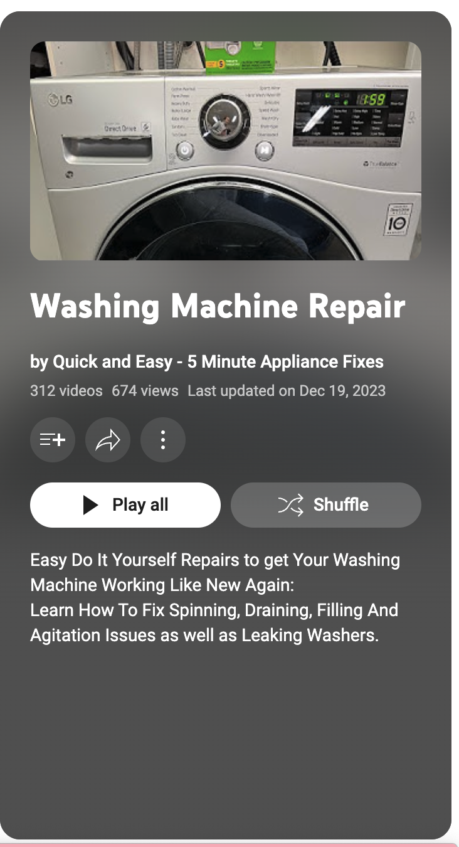
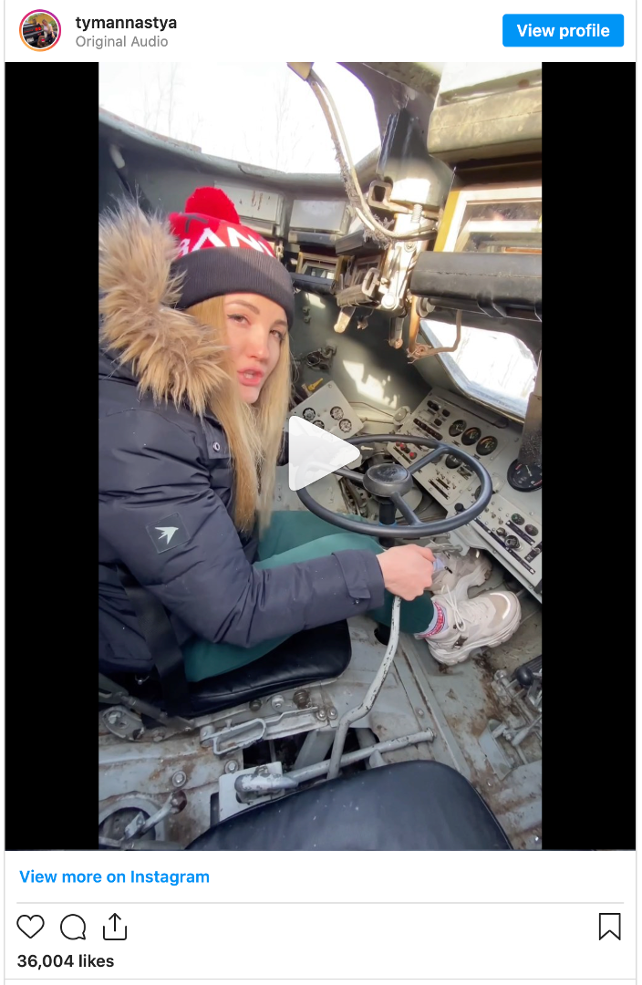

Slide 28
Can general purpose AI do no harm?

Slide 29
I think the answer is no

Slide 30
The role of community

Slide 31
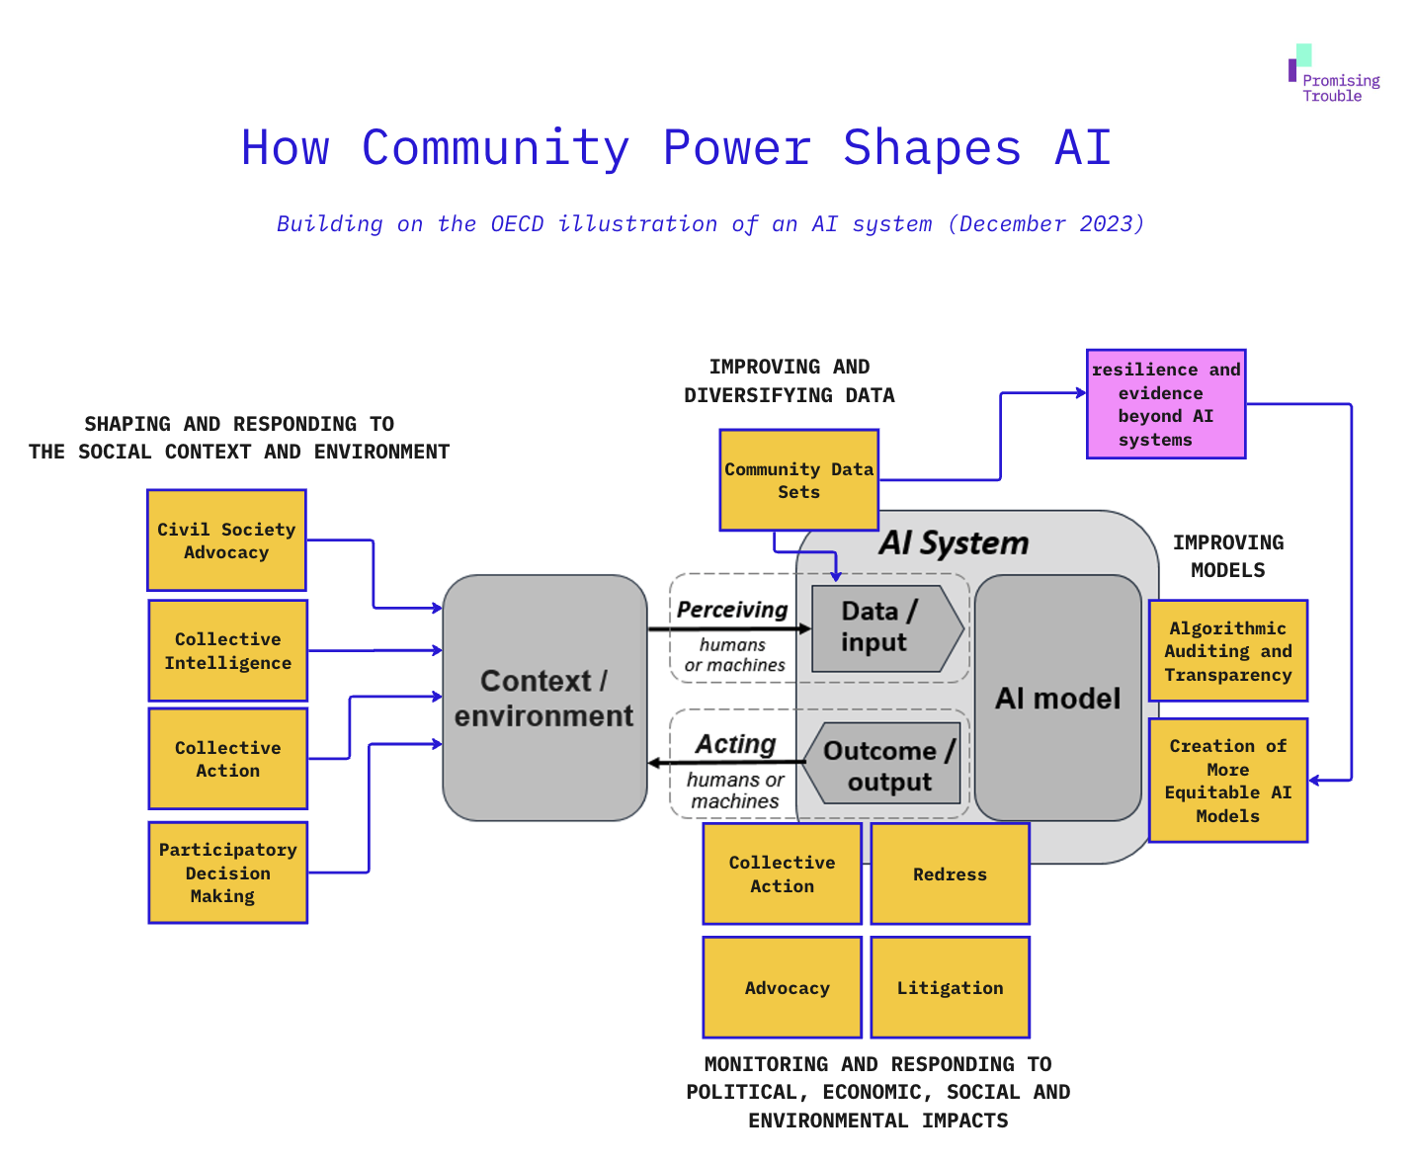

Slide 32
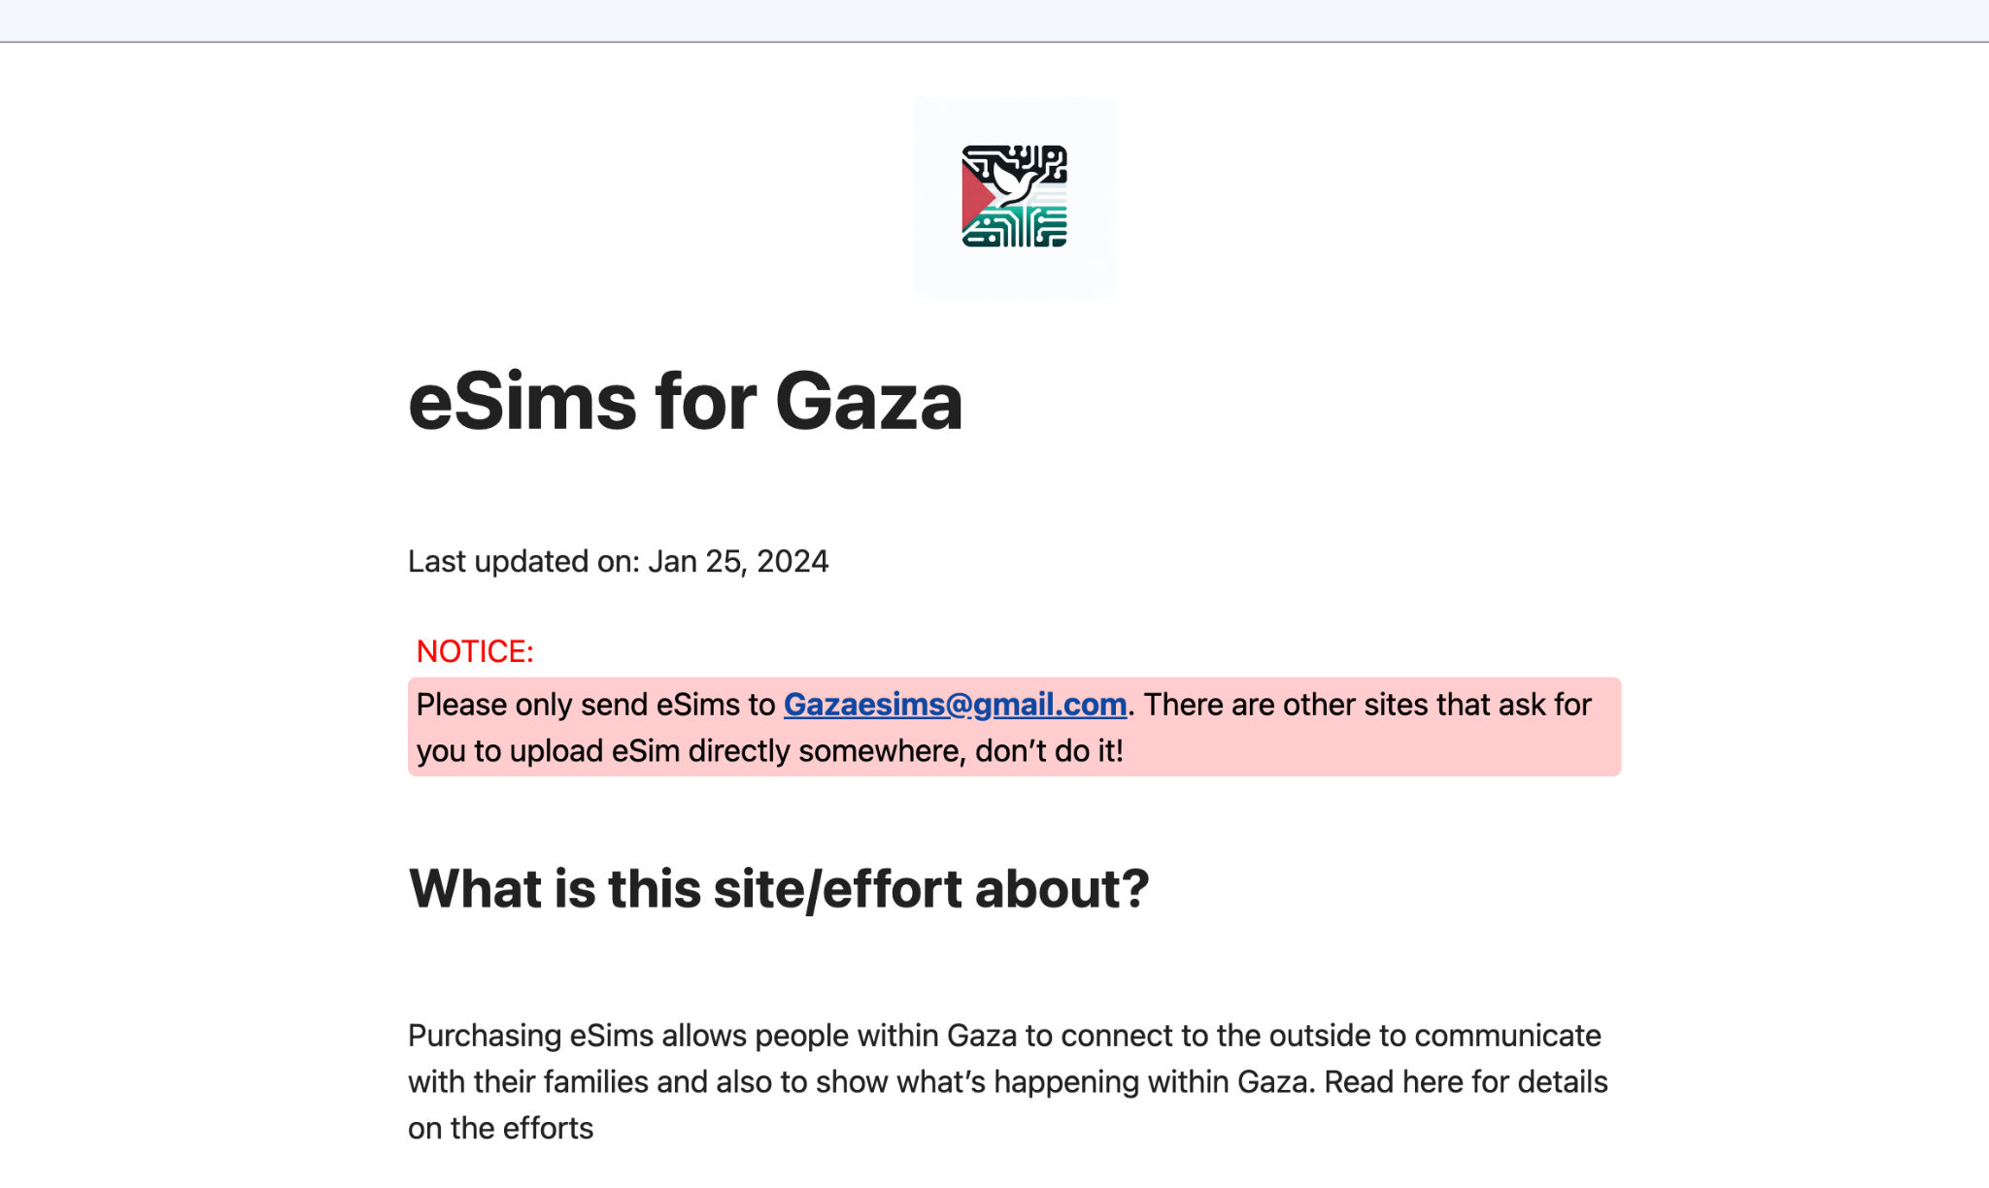
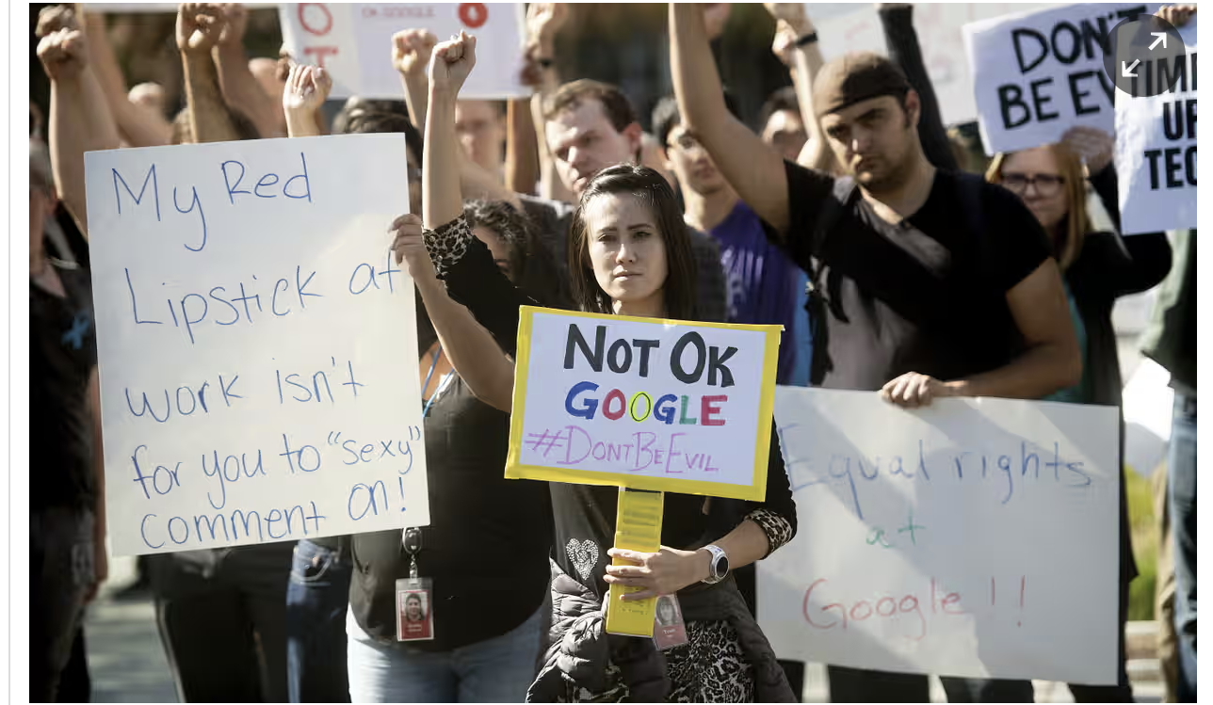
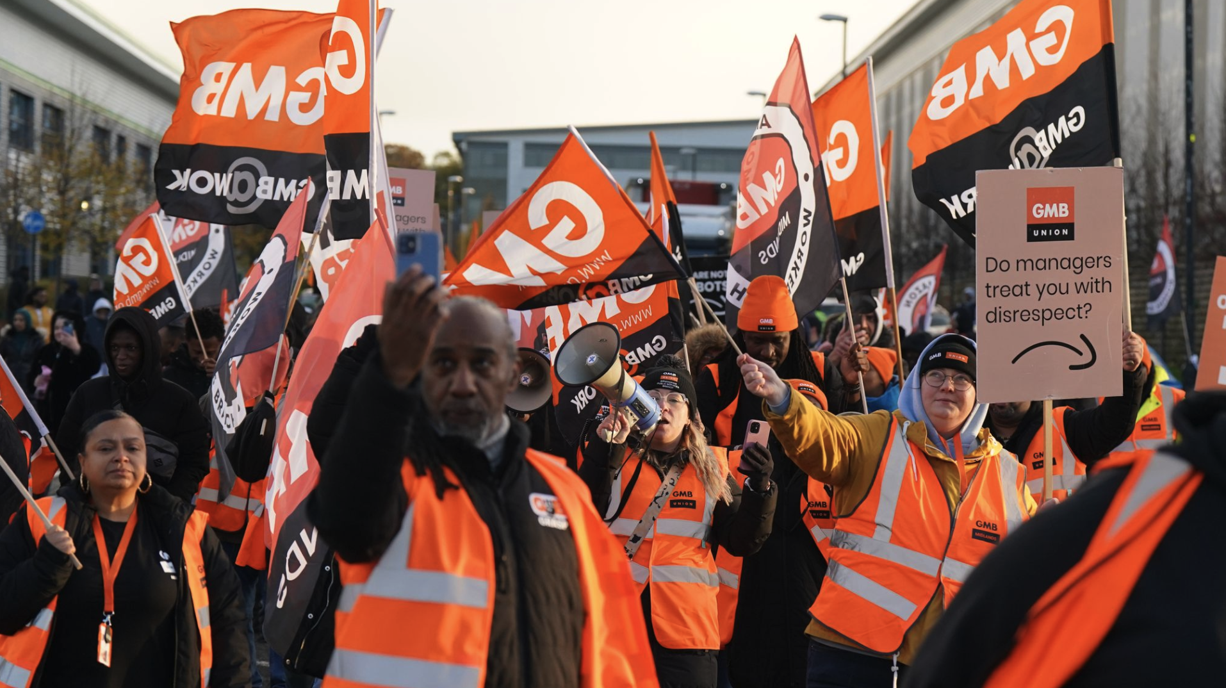

Slide 33
The problem is people and power, rather than technology itself
This is a social problem, and it requires a social answer

Slide 34
Thank you

