Slide 1
How AI is revolutionising the Western Defense Industry – The case of Anduril and Implications for Europe
Jan Quosdorf & Vincent Tadday
7th Annual SYP Conference
‘AI, Peace and Security’
January 27, 2024
King’s College London

Slide 2
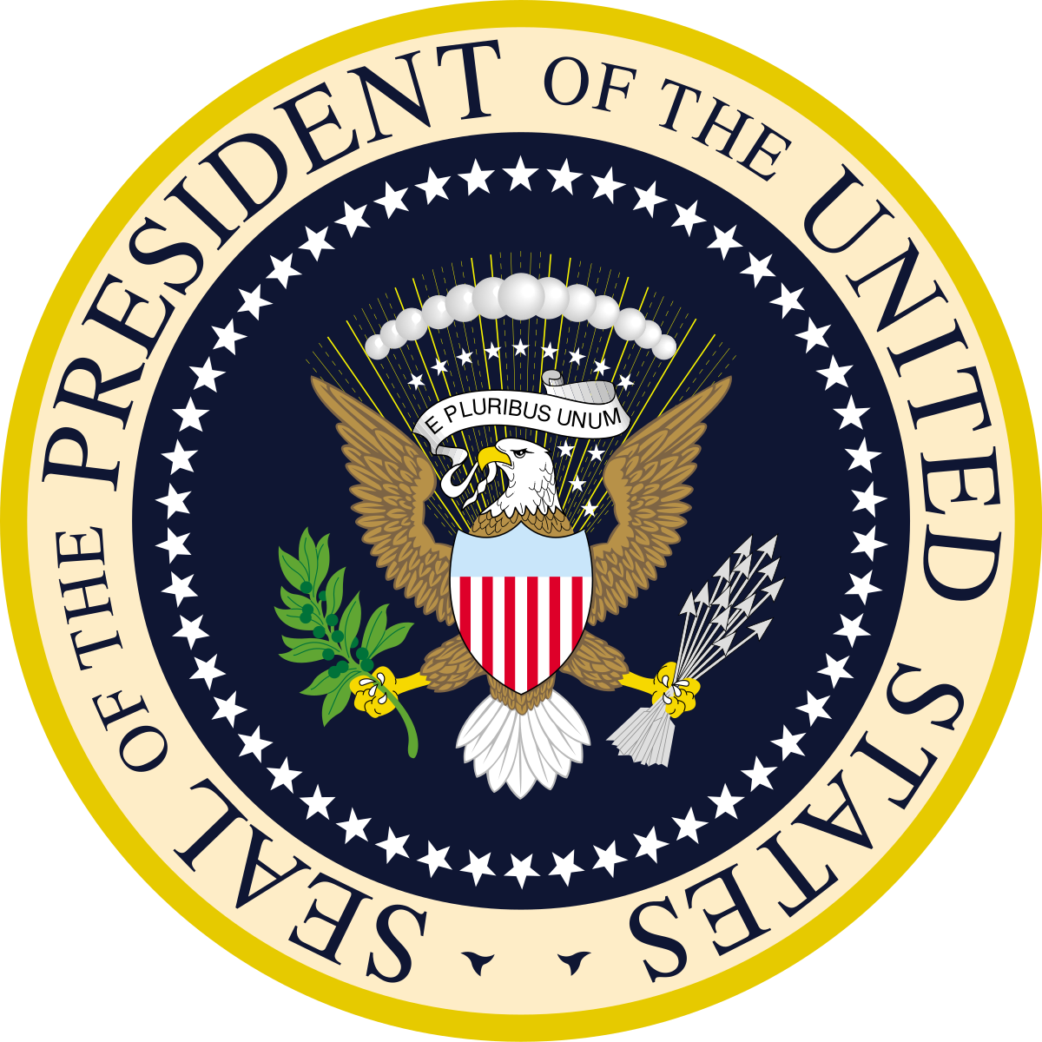
Timeline Anduril and US developments
Expanding Operations
Biden
Since 2021
Broader Defense Industrial Basis
Sells to USA and UK
Acquisition of other startups/small businesses
Products used in Ukraine and Israel-Gaza conflict
Replicator Initiative 2024
Data, Analytics, and AI Adoption Strategy 2023
National Defense Industrial Strategy 2024
Signature Projects 2018
Trump
2017-2021
Major Expansion
Assigned to Project Maven (with Palantir) after Google protests
virtual border wall Customs and Border Protection
Project Maven 2017
National Defense Strategy, AI Strategy 2018
DIU; Joint Artificial Intelligence Center; DARPA AI Exploration program
Launch 2017
First Serious Engagements
Obama
2009-2017
Peter Thiel influence on new Trump administration
Trae Stephens appointed to Trump DoD transition team
Close cooperation with DIU and Homeland Security
2016 National Artificial Intelligence Research and Development Strategic Plan
2014 Defense Science Board (DSB) summer study on autonomy
2014 Defence Innovation Unit experimental (DIUx)

Slide 3
Transition from closed to open innovation systems?
Continuity:
US military R&D structure largely remained after Cold War
Involvement of civilian/external actors not new
Military sector remains important (e.g. absolute real term R&D spending, data provision)
Change:
Relative decline of military…
… sales shares in computing / semiconductor industries
… share of total R&D funding
Institutionalization of relations beyond traditional defense industry
Speeding up of feedback loops (‘DevSecOps’)

Slide 4
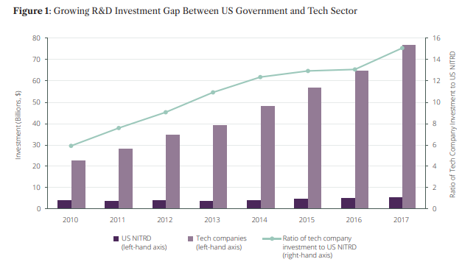
Source: Larry Lewis (2019) Resolving the Battle over Artificial Intelligence in War,
The RUSI Journal, 164:5-6, 62-71, DOI: 10.1080/03071847.2019.1694228

Slide 5
Anduril as forerunner of new (AI) startups in the defence industry?
Continuity:
Market consolidation around five traditional vendors and historically little change through DARPA activities
Anduril already mimics traditional forms of behaviour (e.g. acquiring smaller startups))
Change:
DIU & Replicator Initiative signs of acknowledgement of …
… downsides to traditional cost-incentive model
.. support needed to cross ‘Valley of Death’
Venture capitalists’ investments add to ballooning US defence tech sector
Interest in Silicon Valleys to work for defence industry

Slide 6
Challenges to unique traits of US military innovation?
Continuity:
Increased industry and inter-service competition in developing AI applications for defence
Bipartisan support especially amidst perceived China threat
Majority of PhD graduates in AI field are from abroad
Change:
Differences branches regarding implementation of Multi-Domain Operations concept
Public discussion on ethical use of AI and protests at companies like Google or Microsoft
Graduates or even companies (Google) (re-) turning to China

Slide 7
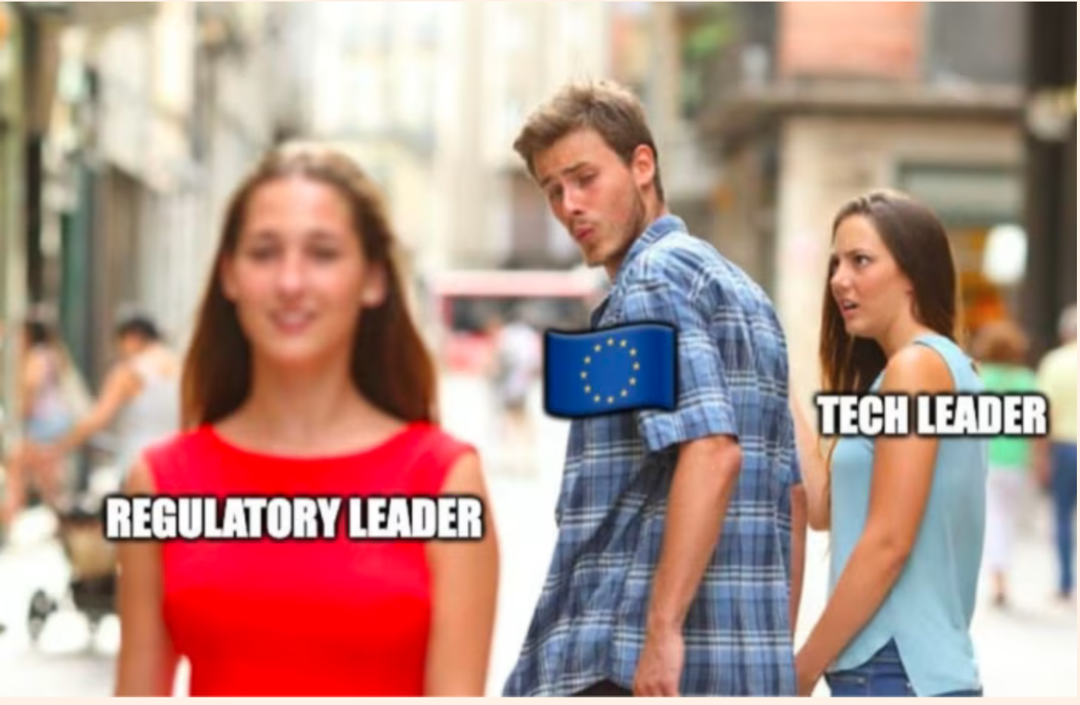
(Non-) existing frameworks:
Lack of public debate regarding questions like:
How does the private ownership of (military) AI technology impact the risk of problematic diffusion?
What are some of the existing frameworks:
NATO Principles of Responsible Use
DoD Responsible AI Strategy
France’s public AI Defence strategy
The EU Artificial Intelligence Act (AI Act)
Excludes military technology!
Source: Financial Times, 2023

Slide 8
Challenges for companies like Anduril on the European Defense Market?
Entry Barriers Faced by Tech Leaders:
Regulatory Compliance
Data Privacy
Long Sales Cycles
European Procurement Systems
Moreover:
Countries have smaller defense budgets
Different security priorities
Rising concern about sovereignty
(Venture-) Capital is missing for innovation
“With European investors significantly trailing the US in defense tech investment, Anduril’s success on the continent was all but assumed. Instead, they've struggled in Europe.”
Bergen et al. (2023)

Slide 9
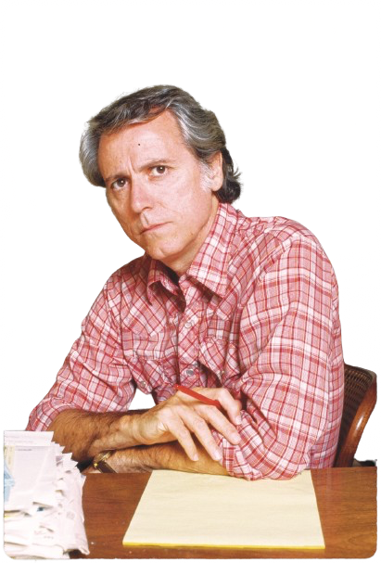
Conclusion:
When war broke out in Ukraine, Anduril expanded aggressively in Europe, expecting that countries’ interest in modernizing their militaries would translate into splurging on Silicon Valley’s latest wares - that has not come true.
A public debate about how we want to deal with AI in military use and warfare is missing.
US tech leaders like Anduril put the European defence market under pressure in the long term - the technology is once again faster than the political decisions around it.
Strategic and regulatory gaps must be filled - better sooner than later!
“War is the ultimate realization of modern technology”
Don DeLillo

