Slide 1
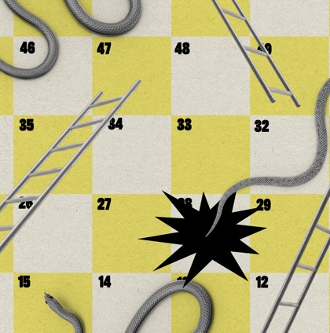
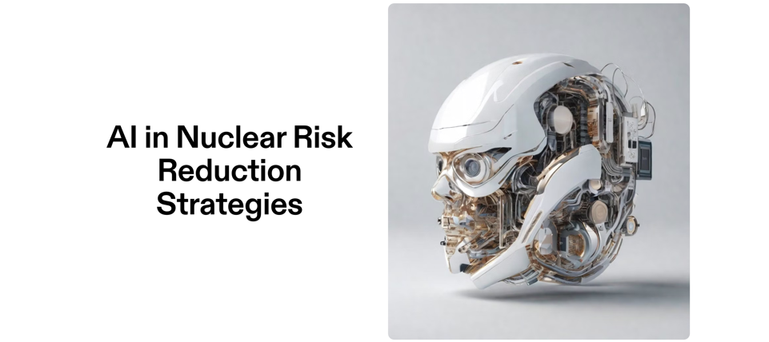
Joel Christoph
PhD researcher
Eui (Florence, italy)
Joel.Christoph@eui.eu
Image: STEPHANIE ARNETT/MITTR | ENVATO
Notes:
Thanks to Dr Tim Street, SYP UK
Or how we can help but won’t necessarily use AI to reduce nuclear risk: complementary innovations, human implementation, data sharing
What I will talk about, what I will not talk about
7th Annual Student/Young Pugwash Conference
January 27, 2024

Slide 2
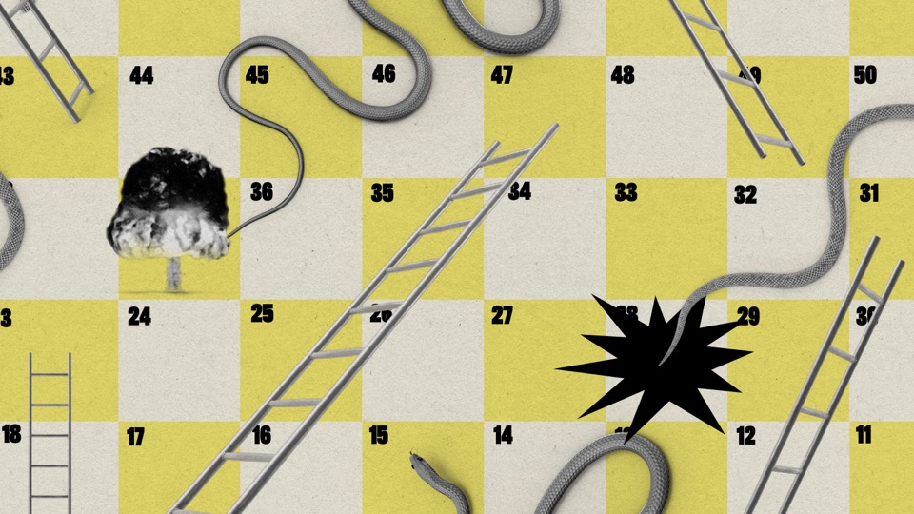
Contents
Nukes, AI system + benefits, connectivity
AI Applications in Nuclear Risk Reduction
Detecting Nuclear Programs
Assessing Treaty Compliance
Reducing Accidental Nuclear Use
Nuclear materials monitoring, surveillance
Predictive analytics and diplomacy
Policy Recommendations: IGOs, Govs, CSOs

Slide 3
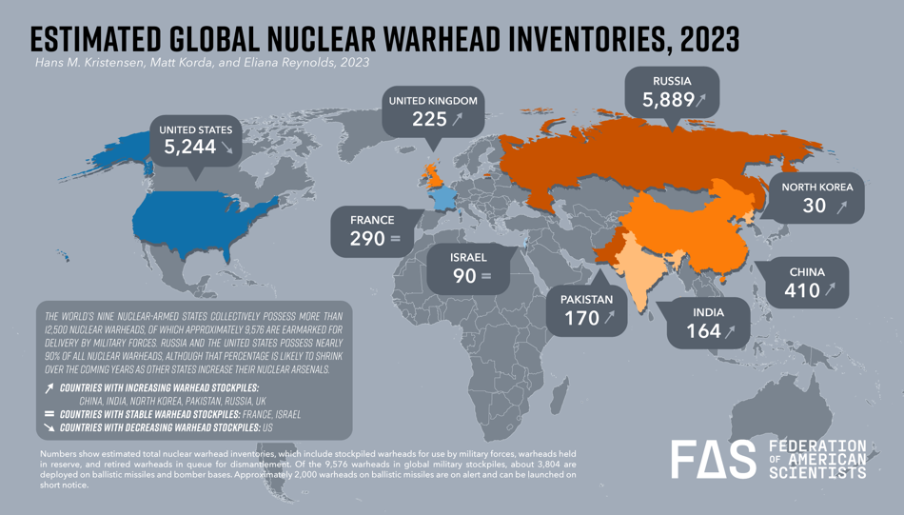
x
Notes:
https://fas.org/initiative/status-world-nuclear-forces/

Slide 4
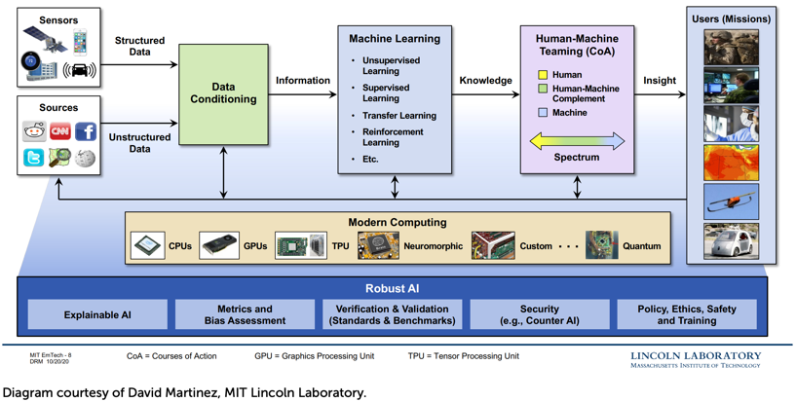
AI System Architecture
Because of its ability to learn through data, ML is particularly useful where the relationship between the data and the result cannot be described analytically.
Notes:
https://www.nti.org/analysis/articles/assessing-and-managing-the-benefits-and-risks-of-artificial-intelligence-in-nuclear-weapon-systems/

Slide 5
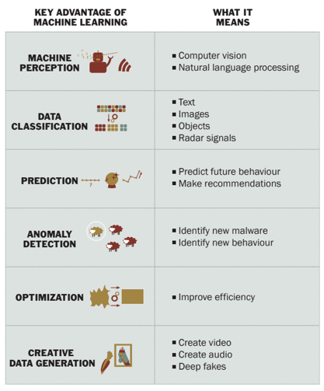
Benefits of machine learning
Notes:
https://www.sipri.org/sites/default/files/2020-06/artificial_intelligence_strategic_stability_and_nuclear_risk.pdf

Slide 6
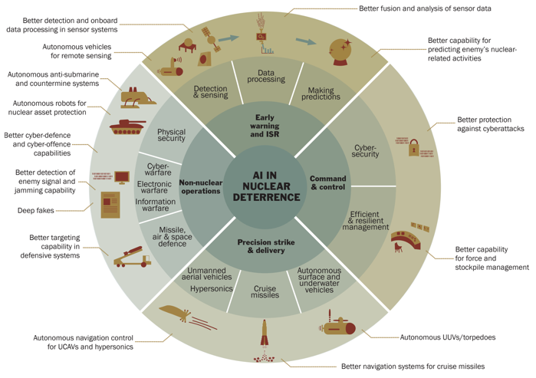
Foreseeable applications of AI in nuclear deterrence
Source: SIPRI
Notes:
https://www.sipri.org/sites/default/files/2020-06/artificial_intelligence_strategic_stability_and_nuclear_risk.pdf

Slide 7
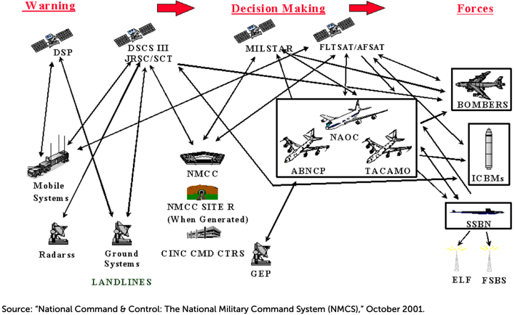
Notional Connectivity for Nuclear Command and Control in the U.S.
Notes:
https://www.nti.org/analysis/articles/assessing-and-managing-the-benefits-and-risks-of-artificial-intelligence-in-nuclear-weapon-systems/

Slide 8
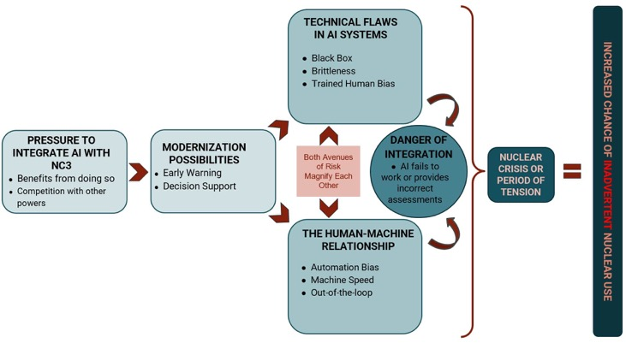
AI/ML + NC3 → increased risk of nuclear weapons use?
NC3: nuclear command, control, and communications
Source: Rautenbach, (2022)
Notes:
Source: Adapted from Artificial Intelligence and Nuclear Command, Control, & Communications: The Risks of Integration, by Peter Rautenbach

Slide 9
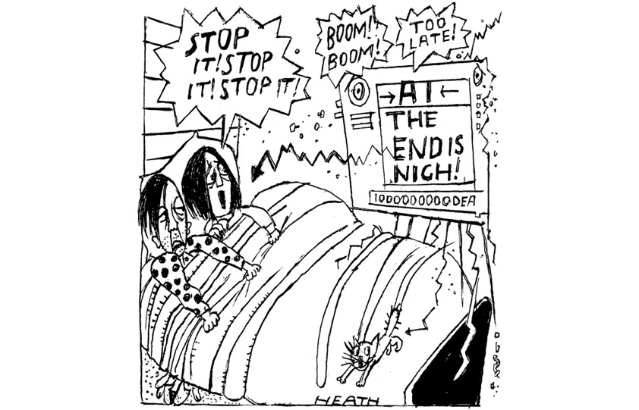
Source: Galeotti (2023)

Slide 10
OK.
So how can risks decrease due to AI?

Slide 11
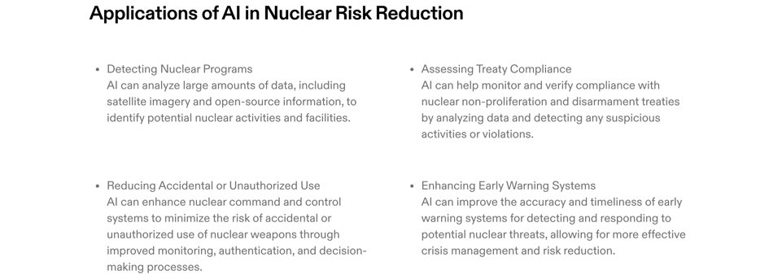
Notes:
Detecting Nuclear Program
AI, ML, and deep learning are being integrated into the nuclear industry to renovate operation systems, including advanced manufacturing techniques​
Larger-scale AI applications are advancing high-energy physics, enhancing the capacity of hadron accelerators and improving tracking detectors in nuclear facilities​
Reducing accidental or unauthorized nuclear weapons use
AI is utilized in radiotherapy for cancer treatment, which indirectly contributes to the safety and precision in the medical use of nuclear technology
AI, ML, and deep learning are applied in renovating operation systems and maintenance systems, indirectly contributing to reducing the risk of accidental or unauthorized nuclear weapons use

Slide 12
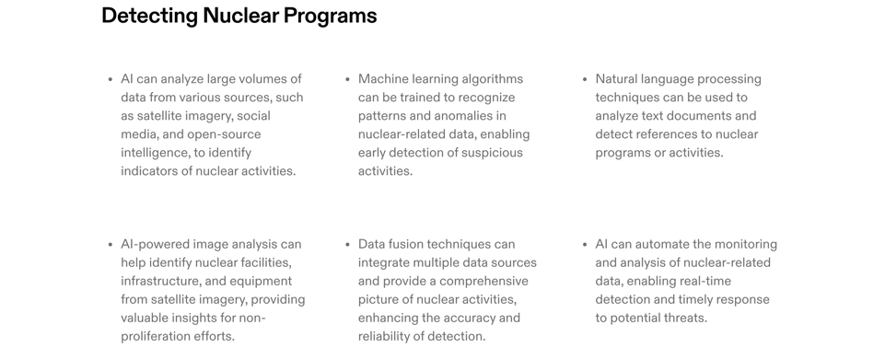
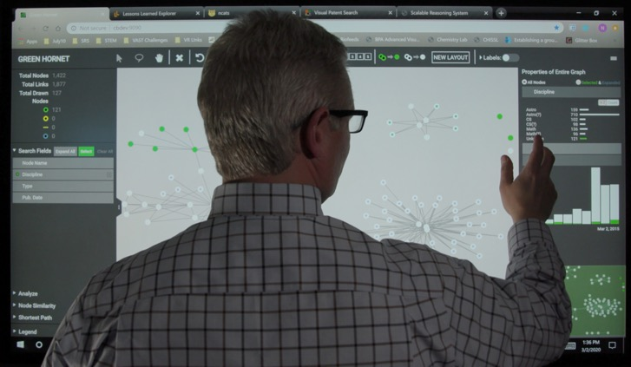
Nonproliferation analyst Ben Wilson and colleagues at PNNL work to develop analytic methodologies to detect the early stages of nuclear proliferation.
Notes:
New research from Pacific Northwest National Laboratory (PNNL) uses machine learning, data analytics, and artificial reasoning to make threat detection and forensic analysis in the nuclear domain easier and faster. By combining these computer techniques with expertise in nonproliferation and safeguards, PNNL works to discover innovative methods by conducting research and turning the research into actionable real-world solutions.
detect early warnings of emerging nuclear weapons programs through characterization of weapons-usable capabilities and/or consideration of advances in civilian, dual-use, and weapons-related nuclear science and technology, and through detection of the intent to change from civilian energy use to weapons use.

Slide 13
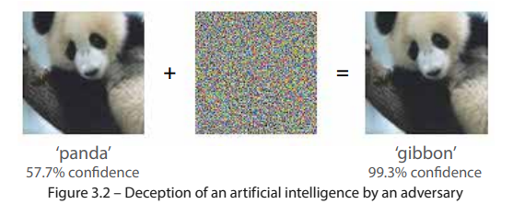
Deception of an AI by an adversary
Source: JCN 1/18, Human-Machine Teaming, Page 30
Notes:
https://forum.effectivealtruism.org/posts/BGFk3fZF36i7kpwWM/artificial-intelligence-and-nuclear-command-control-and-1

Slide 14
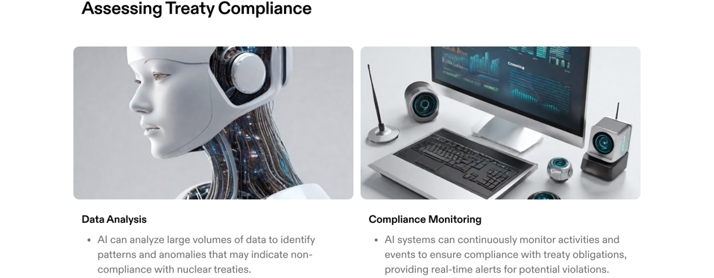
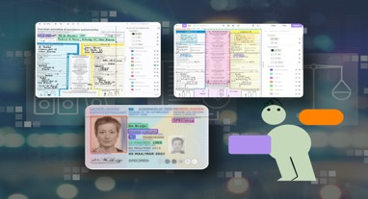

Slide 15
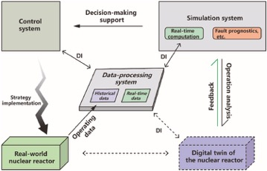
Interaction operation mechanism of a real-world NPP and its digital twin. DI: data interaction.
Source: Huang et al. (2023)

Slide 16
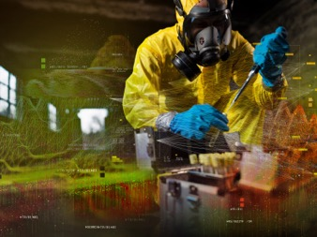
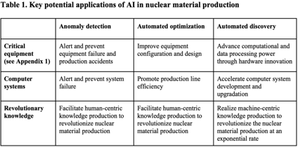
Right: Nonproliferation efforts involve taking regular samples from nuclear facilities. (PNNL, 2022)
Table: He & Degtyarev (2023)
See Huang et al. (2023) for more applications.
Notes:
The use of AI in enhancing tracking detectors and UAVs for radiation detection can be considered as part of monitoring nuclear materials

Slide 17
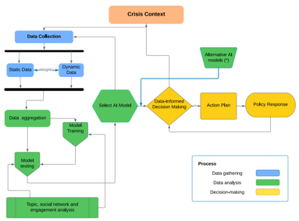
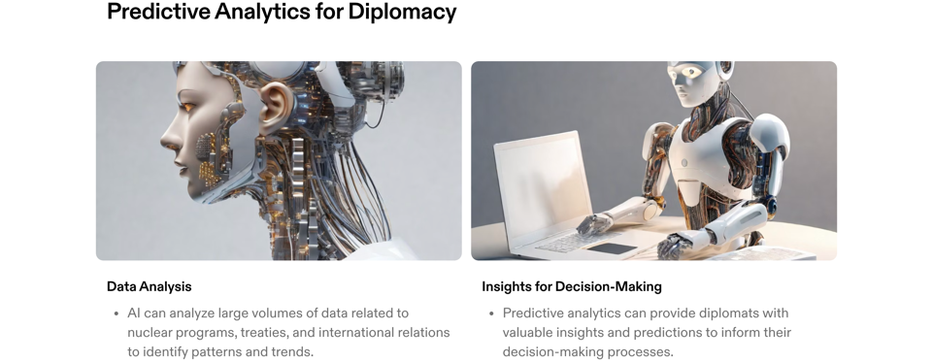
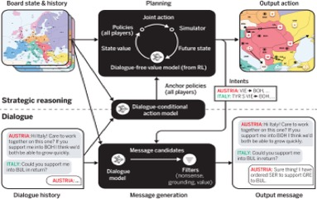
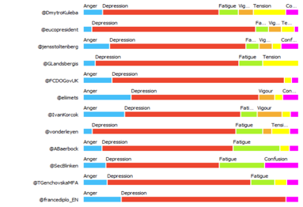
Source: Meta FAIR et al. (2022)
Top: AI-Based Crisis Management Model.
Below: Sentiment analysis by Twitter accounts
Source: Corneliu Bjola (2022)

Slide 18
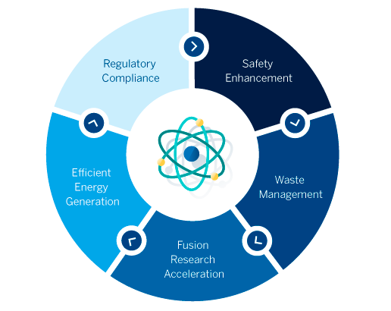
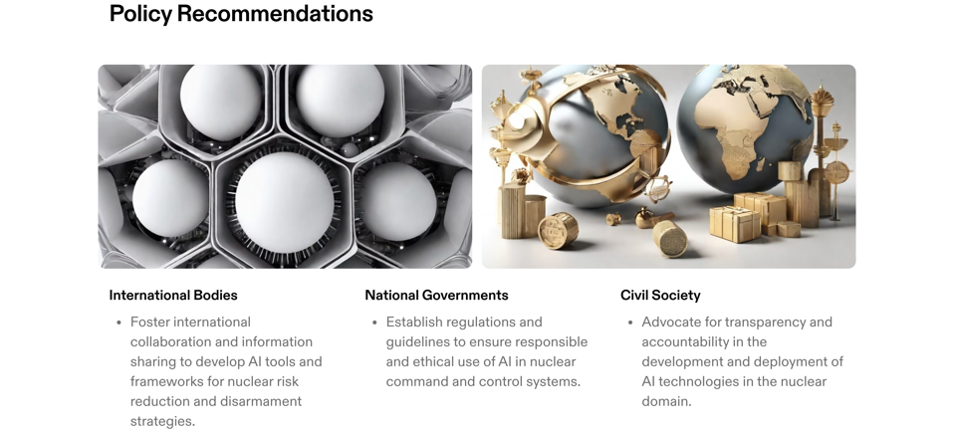
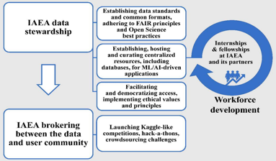
Left: IAEA’s role in accelerating progress in nuclear applications, science and technology using AI and ML methods.
Right: Banafa (2023)
Notes:
a. international bodies,
b. national governments,
National governments could focus on the integration of AI in nuclear system design and operation to enhance safety, reliability, and efficiency
c. civil society to ensure AI contributes positively to global peace and security efforts in the nuclear domain.
Civil society organizations can advocate for the responsible and ethical use of AI in nuclear technologies, emphasizing safety and risk reduction.

Slide 19
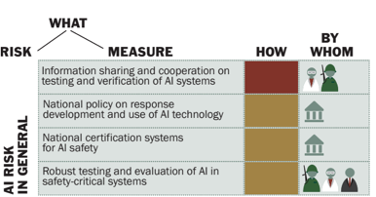
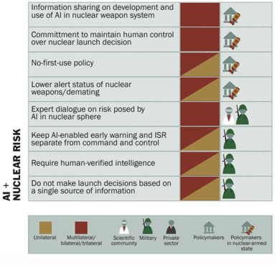
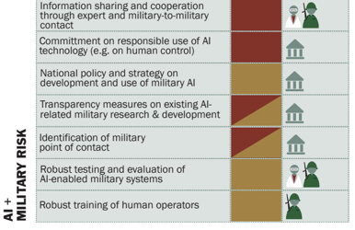
More risk reduction measures and how they can be implemented
SIPRI: AI, Strategic Stability, and Nuclear Risk
Notes:
https://www.sipri.org/sites/default/files/2020-06/artificial_intelligence_strategic_stability_and_nuclear_risk.pdf

Slide 20
But what does AI not change?
OK.

Slide 21
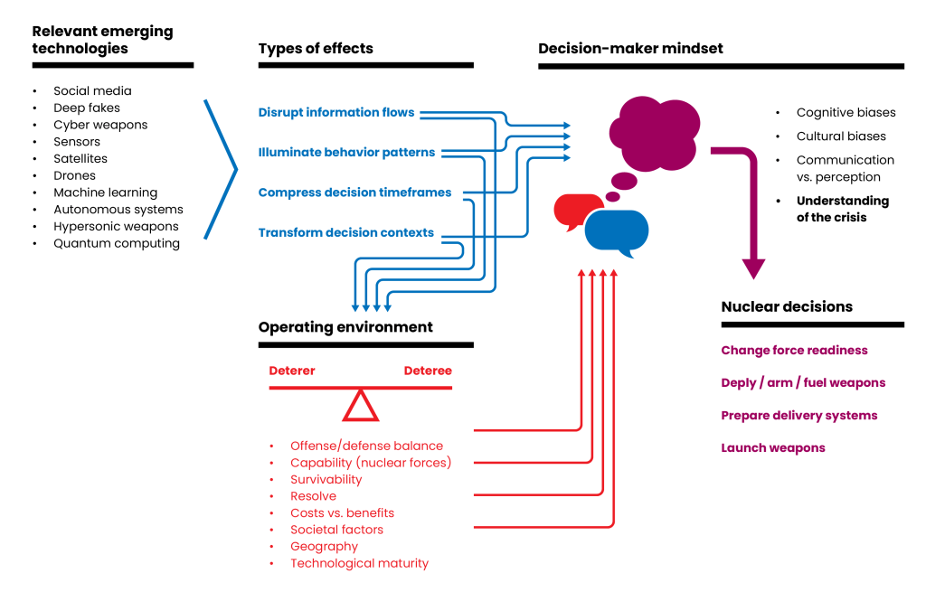
Impact of EDTs on the decision-making context, mindset, decisions
Source: Bajema & Gower (2022)

