Slide 1
AI for Peaceful Use of Nuclear Energy: Future Prospects
Syeda Saba Batool

Slide 2
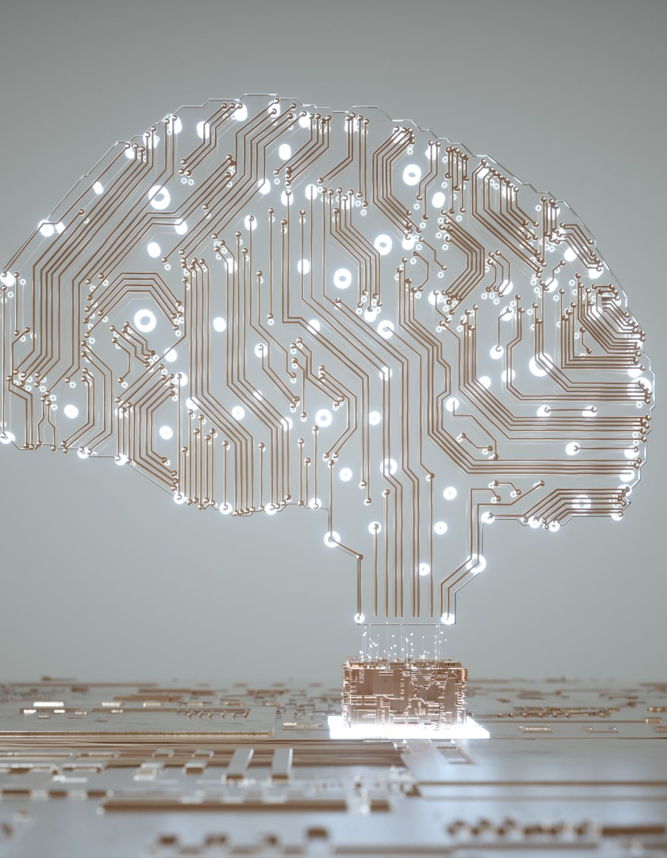
What is Artificial Intelligence?
The term AI, coined in the 1950s, refers to the simulation of human intelligence by machines. It covers an ever-changing set of capabilities as new technologies are developed. Technologies that come under the umbrella of AI include machine learning and deep learning.
Artificial intelligence is the simulation of human intelligence processes by machines, especially computer systems.
Specific applications of AI include expert systems, natural language processing, speech recognition and machine vision.

Slide 3
AI programming focuses on cognitive skills that include the following:
Learning.
Reasoning.
Self-correction.
Creativity
Machine learning enables software applications to become more accurate at predicting outcomes without being explicitly programmed to do so. Machine learning algorithms use historical data as input to predict new output values. This approach became vastly more effective with the rise of large data sets to train on.
Deep learning, a subset of machine learning, is based on our understanding of how the brain is structured. Deep learning's use of artificial neural network structure is the underpinning of recent advances in AI, including self-driving cars and ChatGPT.

Slide 4
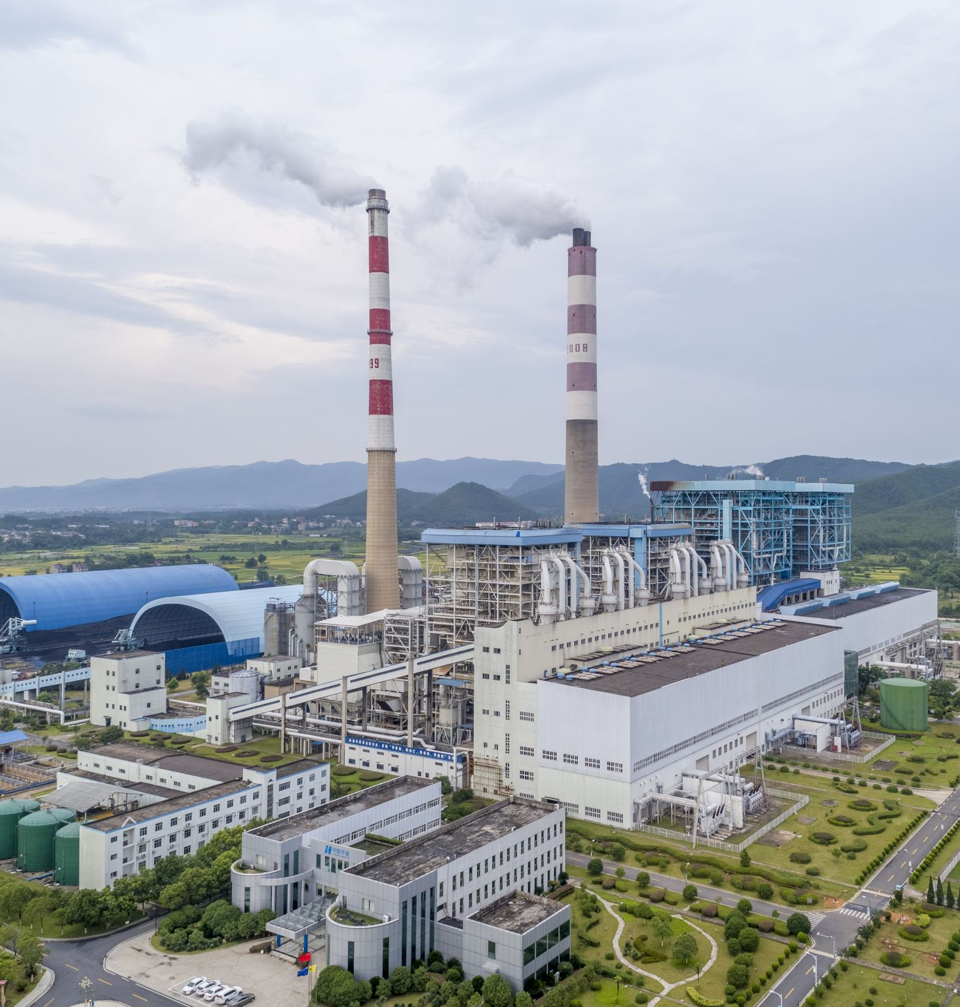
Peaceful Uses of Nuclear Energy
Nuclear energy and technology are indispensable for the advancement of humankind. They provide needed leverage for raising human welfare, which makes them particularly important for developing countries in their efforts to achieve the 2030 Agenda for Sustainable Development.
Article IV of the NPT recognizes the inalienable right of every State to the peaceful uses and development of nuclear energy.
Peaceful uses of nuclear energy can uniquely contribute to medicine, public health, agriculture, food security, water resources management, sustainable energy and the environment, to name only but a few areas.
Cooperation in peaceful uses requires resources, sharing of knowledge, know-how, technology, information and best practices.

Slide 5
Nuclear Energy for Sustainable Development
Nuclear energy is key to achieving global net zero objectives, working in partnership with renewable energy sources and other low carbon options, as part of a sustainable energy system to decarbonize electricity and non-electric energy production.
This can help in achieving SDG 7 (Affordable & Clean Energy) and contribute to SDG 13 (Climate Action).
Nuclear Energy for Agriculture can contribute to SDG 1 (No Poverty), SDG 2 (Zero Hunger), and SDG 10 (Reduced Inequalities)

Slide 6
AI for Peaceful Use of Nuclear Energy
AI can help in harnessing benefits from peaceful applications of Nuclear Technology
Human health
AI can contribute to combating diseases. It is already applied to support the diagnosis and treatment of cancer through improved image interpretation and precise tumor contouring, enabling more accurate treatment plans and adaptive radiotherapy.
Food and Agriculture
AI tools combined with nuclear technologies can help make food systems more sustainable and climate change resilient, while also addressing food and nutrition insecurity. Experts deploy AI to process and analyse data to increase crop yields, estimate soil moisture, remediate radioactively contaminated land, detect and predict food fraud events and improve irrigation.

Slide 7
Water and the environment
Experts already apply AI-based approaches to quickly analyse huge amounts of water-related isotopic data stored in global repositories, such as the Global Network of Isotopes in Precipitation maintained by the IAEA and the World Meteorological Organization. Effective and efficient analysis of data facilitated with AI helps scientists understand climate change and its impact on water availability worldwide.
Nuclear science and fusion research
AI is used in data analysis, theoretical modelling and experiment design, helping to accelerate fundamental research, for example in the realm of nuclear and atomic data evaluation and compilation, and advancing technological innovation. A particular area that benefits from the application of AI is fusion research. With its ability to solve large and complex problems, AI can aid experiments and scientific discovery through modelling and simulations.

Slide 8
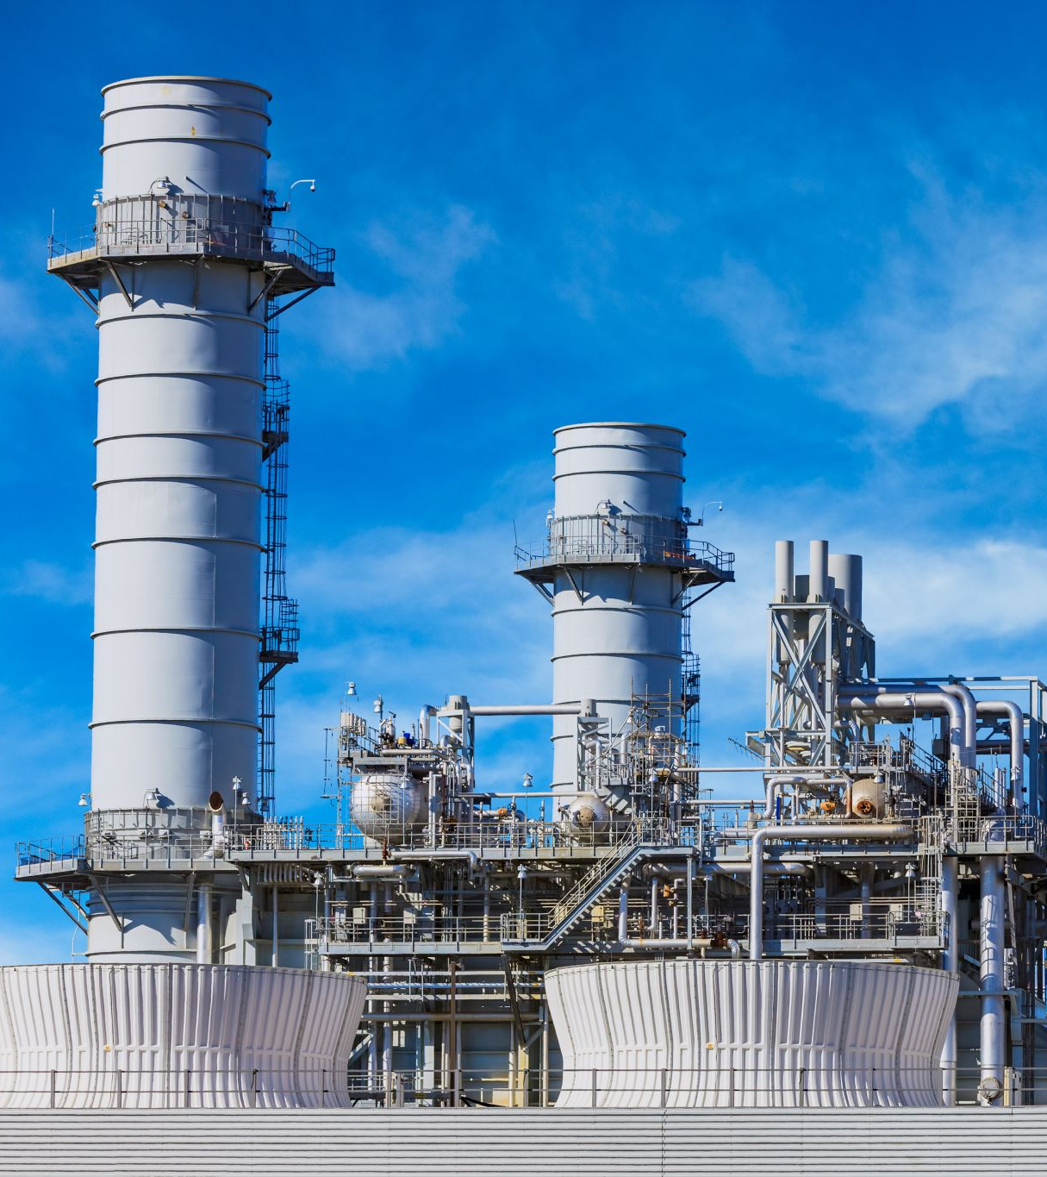
Nuclear Power
By combining digital simulations of real nuclear facilities with AI systems, the industry can optimize complex procedures and improve reactor design, performance and safety. Such optimization can increase the efficiency of operations and reduce maintenance costs.
Machine learning — a process whereby AI learns by analysing large amounts of data — helps to automate tasks and thereby increase reliability and avoid errors. Furthermore, AI has considerable analytical and predictive potential to help monitor power plant processes and detect anomalies.

Slide 9
Nuclear Security and Radiation Protection
AI can contribute to nuclear security and safety in several ways. It can be used in the processing of data from radiation detection systems to enhance the detection and identification of nuclear and other radioactive material.
It can be applied to analyse data from physical protection systems to improve the detection of intruders. It can also help spot anomalies that could indicate a cyber-attack on a nuclear facility.
In the realm of radiation protection, the integration of AI in safety standards-related software can reinforce the protection of the millions of workers with occupational exposure in medicine, construction, mining, shipping, agriculture and nuclear power.

Slide 10
Nuclear Safeguards
Safeguards are technical verification measures through which the IAEA provides credible assurances that countries are honouring their legal obligations to use nuclear material for peaceful purposes only.
Safeguards rely on large amounts of data obtained by various means, such as satellite imagery, environmental sampling, gamma ray spectroscopy and video surveillance. AI can help nuclear inspectors and safeguard analysts with the analysis of these data. Machine learning methods have already been used to detect outliers in large datasets and assist in verifying spent fuel and analysing surveillance recordings.

Slide 11
AI Potential Applications in Nuclear Material Production
In industries, AI does three main things: it spots oddities, makes things work better, and discovers things automatically. AI’s anomaly detection has two key uses. First, it helps industries monitor and fix machine problems, like with centrifugal pumps. Second, it plays a role in cyber defense, protecting critical systems from cyber threats. A real-world example is General Electric’s Digital Ghost, which safeguards the US Department of Energy’s infrastructure, including enriched uranium.
These AI applications can be used in nuclear material production too, enhancing safety and efficiency. AI can prevent breakdowns in crucial equipment and improve processes related to making nuclear materials.

Slide 12
Automated Optimization and Automated Discovery
Automated optimization
Automated optimization solutions train AI algorithms to analyze data with predefined parameters in an industrial process.
Automated discovery
AI algorithms are trained to understand the rules of a game by identifying key parameters at an initial stage, then developing their own algorithms to determine the best solution for the game. AI has demonstrated its capability to revolutionize the scientific world at an exponential rate. Nevertheless, in the nuclear sciences, the application of automated discovery remains in early development stages.

Slide 13
IAEA’s and AI Advancements
The IAEA provides interdisciplinary fora for professionals to discuss and foster collaboration on the use of AI in nuclear applications, science and technology and is committed to sharing knowledge and forging partnerships through its AI for Atoms platform.
The IAEA cooperates with the International Telecommunication Union, the UN Interagency Working Group on AI and almost 40 other UN organizations to provide a solid foundation for accelerated sustainable development with AI.
AI holds promising potential for advancing nuclear energy production. AI, together with other technologies, like digital twins, could decisively boost the efficiency of nuclear power production.
AI robots are being increasingly used in nuclear facilities for tasks like locating and handling nuclear materials. These robots, equipped with advanced technologies such as 3D modeling, virtual reality, and drones, help in efficient data collection, enhance safety, and reduce costs during decommissioning activities. Countries, including Japan, are employing innovative robotic technology for tasks like retrieving and disposing of fuel debris. The use of AI robots is a high-tech solution that contributes to effective project implementation and risk reduction in nuclear decommissioning.

Slide 14
Future Prospects
Governments should be in charge of overseeing data and infrastructure related to nuclear material production, adapting existing rules for new technologies like AI. It’s essential to focus on regulating the transfer of sensitive data and advanced information infrastructure associated with AI in nuclear material production.
To bridge the gap between the nuclear sector and AI experts, there should be a three-step approach: understanding AI’s role in nuclear production, involving AI industries in policy discussions, and establishing advisory boards. This can enhance knowledge exchange and contribute to effective export control guidelines.

Slide 15
Encourage ethical AI in the nuclear industry by emphasizing compliance with guidelines and regulations. Civil society plays a vital role as watchdogs, exposing risks associated with AI in nuclear material processing. Companies aligning with UN sustainability goals can be influential, and civil society efforts can create grassroots initiatives for responsible AI practices in the industry.
Replace human labor with AI generated robots and technologies to reduce the cost of the labor considering that the IAEA budget has not increase but is still the same and the number of the IAEA projects are increasing.

