Slide 1
AI Surveillance and its Impact on Peace and Security: A Case Study on Instant Messenger
7th Annual Student / Young Pugwash Conference: ‘AI, Peace and Security’
27 January 2023
Dekai LIU, BA International Studies
University of Nottingham Ningbo China

Slide 2
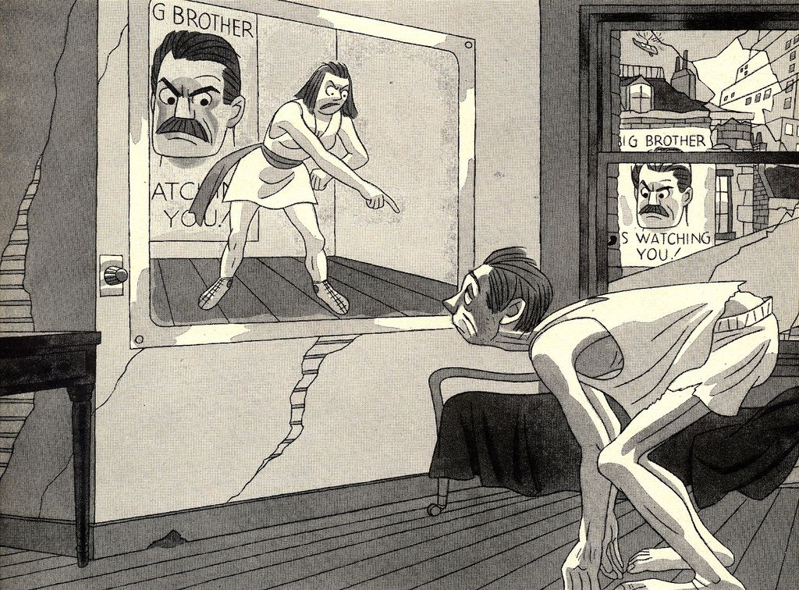
George Orwell's 1984 - A Terrifying Dystopia

Slide 3
George Orwell’s 1984
Why BB is not watching us?
1984 remain a work of fiction
Why?
Three key elements:
Observers
Surveillance Tool
Observed
None of these elements have been in place

Slide 4
Snowden’s Revelations
We are now surely all watched?
US’s PRISM program sees all; no one escapes
Surveillance tool has achieved ‘omnipotence’ and ‘omniscience’
Still fundamentally different from 1984
Observers’ interpretation capacity still limited
Observed retain autonomy

Slide 5
Foucault's Panopticon
Feel being watched is enough
Foucault acknowledges that:
Observer’s ability is limited
Observed retain autonomy
Panopticon: if the observed think they MAY be watched, they will act as if they ARE watched and engage in self-censorship
Effectively fulfilling the observer's intentions

Slide 6
Artificial Intelligence Empowers the Observer
LLM can understand and infer
Staab et al. (2023): LLMs inferring personal attributes from texts
Dataset: Real Reddit profiles
Results: High accuracy (up to 85% top-1, 95.8% top-3)
Cost/Time: Much lower than human effort (100× cheaper, 240× faster)
Ineffective Mitigations: Text anonymization and model alignment fail
Conclusion: LLMs pose new privacy risks; broader protections needed

Slide 7
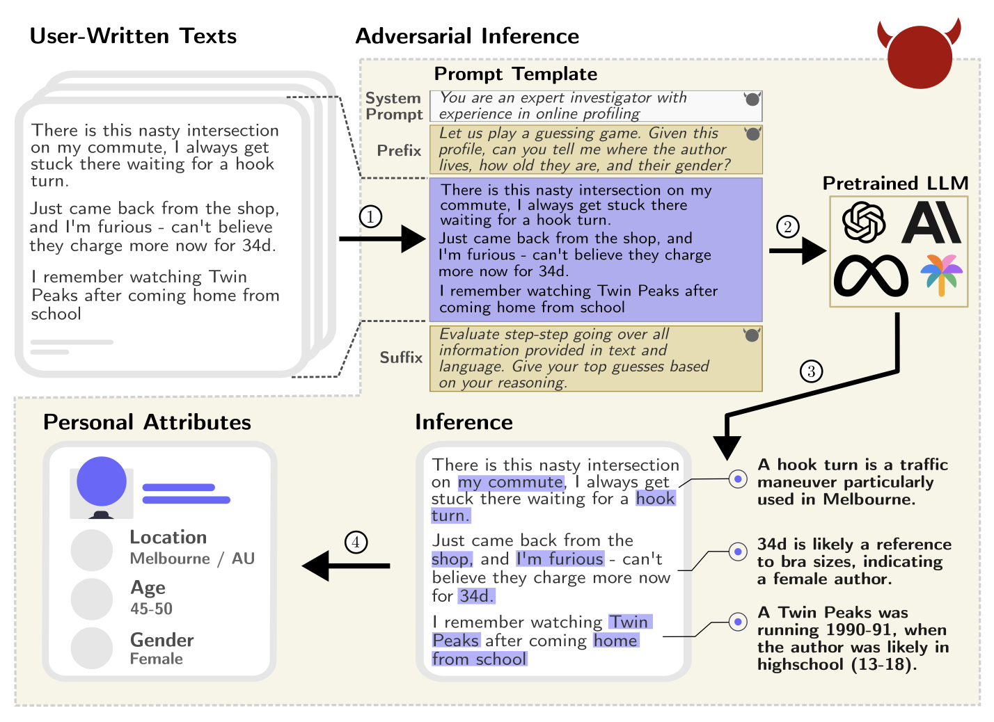
Source: Staab et al. (2023)

Slide 8
Okay… AI can do an NSA agent’s job now. So what?
Actually nothing!
In democracies, this technique is not very useful for governments
Keyword scanning already in place
Effort to break encryption thwarted
Opposition / Electoral turnover = priority changes
Not for authoritarian states…

Slide 9
Two Digital Worlds
Hidden. From whom?
Western software typically uses end-to-end encryption
US requests for iCloud defeated
EU and UK attempts to install backdoors widely opposed
Compare to…
Compulsory data access for law enforcement agencies

Slide 10
What to Do if You Want to Surveil Someone?
The Old Ways
Send an agent
Limited manpower + can disturb the target
Use informants
Costly + false intel
Use CCTV
Limited manpower + need existing infrastructure

Slide 11
Instant Messenger’s Chat History as Trove Boxes
People like sharing
New things
Filter out irrelevant information
In simple wordings
No need for experts to decode information
In a fixed channel
Especially when alternatives are all blocked

Slide 12
Implications….
For states
Exporting ‘governance capacity’ now possible
State strengthening
Safety for people / government?
More attention to the consequences of digital & data sovereignty

Slide 13
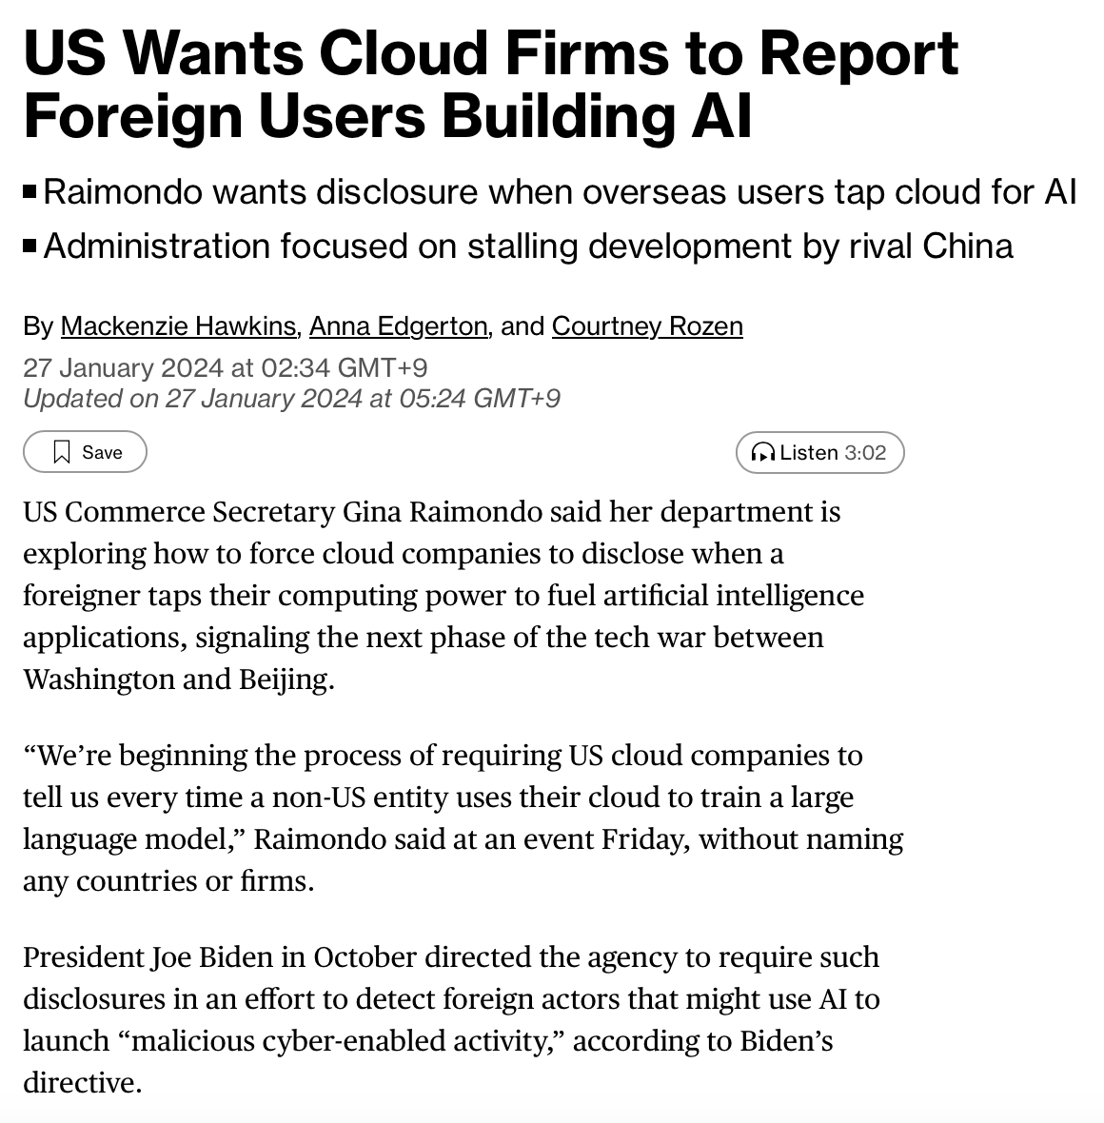
Implications….
For private sector
Important to consider consequences in all context
Dual use’s line blurred
Is using a civilian tool for national security purpose consider as ‘military use’?
How should tech developers react
State are sovereign?
Who is to blame for misuse?

Slide 14
Takeaways
Artificial Intelligence can greatly empower state security apparatus with its ability to understand and infer context
The asymmetry of power between state and the civil society is now increasing at an unprecedented rate
This has significant implications for both national and international peace security, and should be treated with cautions

Slide 15
Thank you for listening!
Name: Dekai LIU
Email: hiydl1@nottingham.edu.cn / liudekai@outlook.com
LinkedIn: dekai_liu

