Slide 1
DECODING AI HYPE
Unveiling the Overrated Problems for a Race Against Time
Océane Van Geluwe
7th Annual SYP Conference: AI, Peace and Security

Slide 2
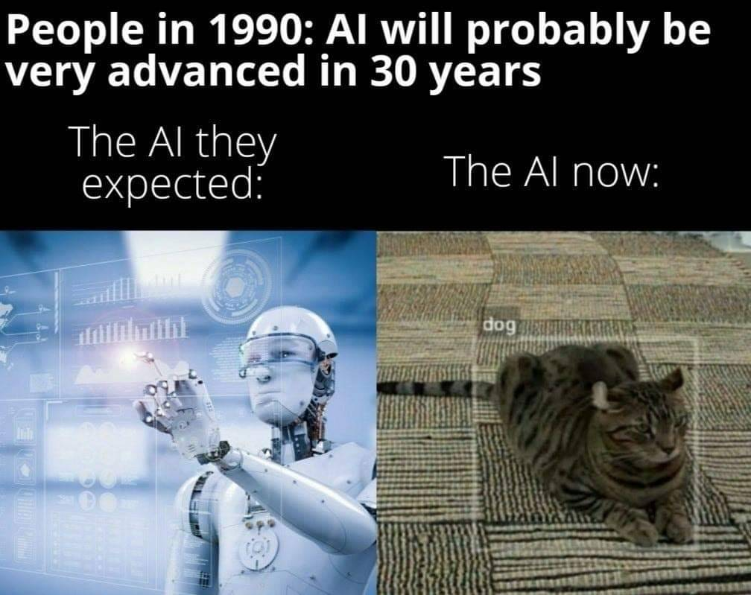
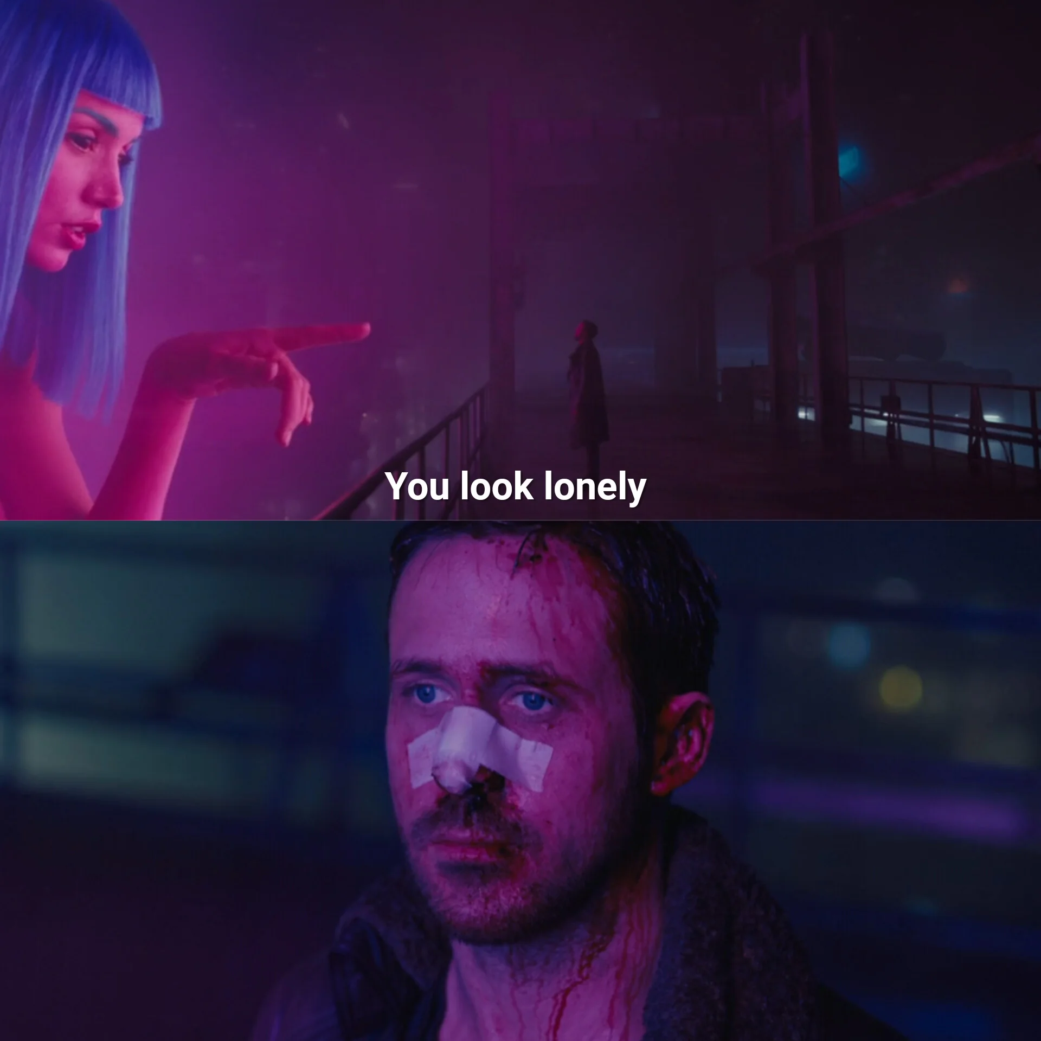
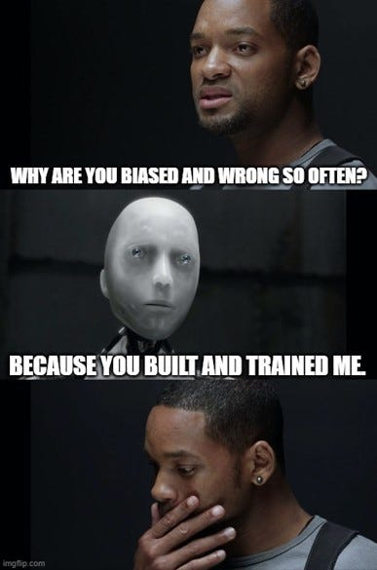
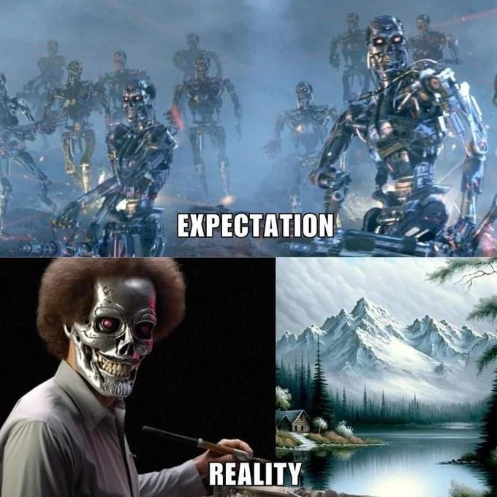
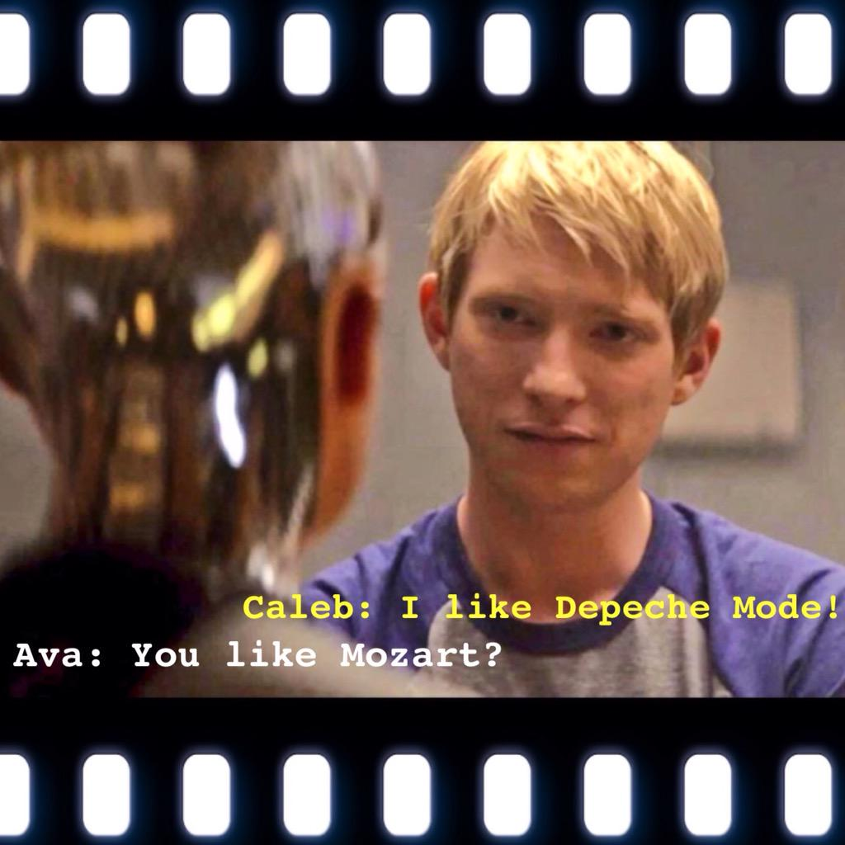
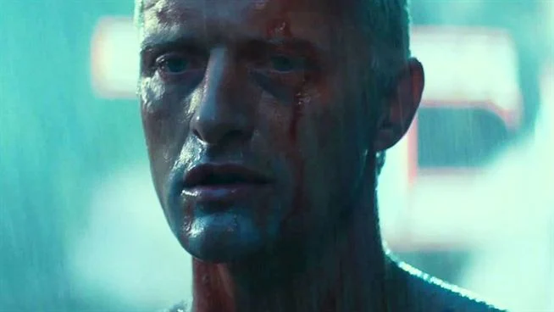
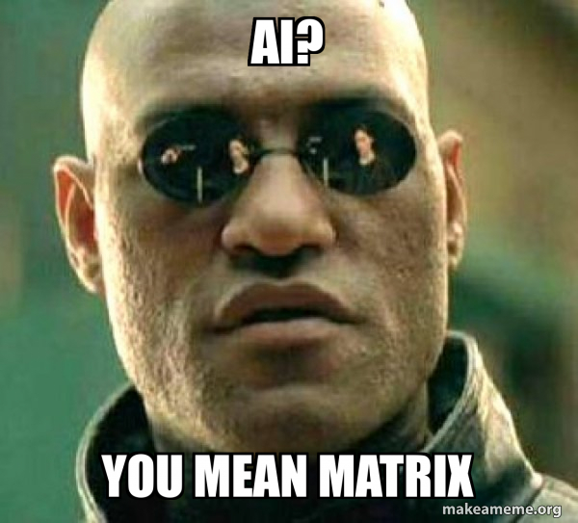
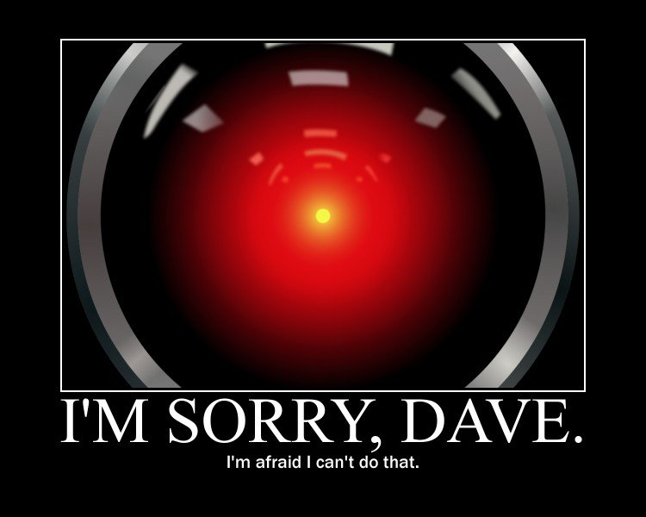
AI ?

Slide 3
Artificial + Intelligence?
‘’We propose that a 2 month, 10 man study of artificial intelligence be carried out during the summer of 1956 at Dartmouth College in Hanover, New Hampshire. The study is to proceed on the basis of the conjecture that every aspect of learning or any other feature of intelligence can in principle be so precisely described that a machine can be made to simulate it. An attempt will be made to find how to make machines use language, form abstractions and concepts, solve kinds of problems now reserved for humans, and improve themselves. We think that a significant advance can be made in one or more of these problems if a carefully selected group of scientists work on it together for a summer.”
– Dartmouth proposal, August 1955¹
“the conference did not go as planned and the results were somewhat inconclusive.”²

Slide 4
Why does it matter?
”Regarding the influence of entertainment media on perceptions of AI, we found a significant relationship (p < 0.5) between people’s beliefs about AI in entertainment media and their beliefs about AI in reality. Those who believe AI is realistically depicted in entertainment media were more likely to see AIs as potential emotional partners or apocalyptic robots than to imagine AIs taking over jobs or operating as surveillance tools.” – Nader K, et al. 2022⁴
“I understand what counts as artificial intelligence”
“Do you consider these to be AI?”

Slide 5
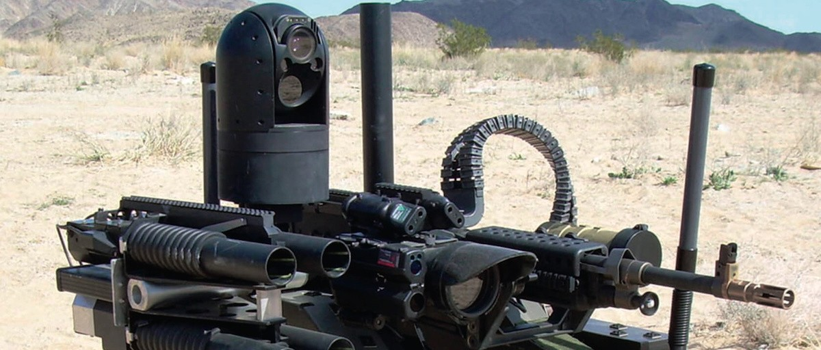
A misinterpretation ?
“The myth of the creation of intelligence is embedded in a historical context fueled by popular fantasies surrounding creatures turning against their creators, the fear that robots might replace us in our work, and various programs created in recent years by IBM, Facebook, and others. It all began with the desire to imitate or become God.” – Luc Julia³
Planning, Scheduling, & Optimization
Expert systems
Speech
Natural Language Processing (NLP)
Machine Learning
Deep Learning
Predictive Analysis
Translation
Classification & clustering
Information extraction
Speech to text
Text to speech
Robotics
Vision
Image recognition
Machine vision
Illustration: AI different “types”

Slide 6
What are the AI-risks today?
« A hammer is stronger than us to bang a nail, but it only does that [originally]. Artificial Intelligence, it is the same! » - L. Julia⁵
AI risks (or fancier titles)
Known Knowns
Big brother on the way? Big data/Privacy
Conception Bias (Twitter’s Tay)
Mission bias
Known Unknowns
Unknown Knowns
Extent of AI use – where to next?
Unknown Unknowns
Going to AI awareness?
Security Concerns
Status quo challenged no matter the fields
Economy
Other Biases in IA decision making
Health
Cascading effects (IoT implementation, etc.)

Slide 7
Policy Recommendations
Policy
Enhance Public Awareness
Establish Collaborative Regulatory Sandboxes
Mandatory Algorithmic Impact Assessments
provide accurate information, dispel myths, and foster informed discussions about AI.
Likelihood of success: relative with disparities across generations.
Regulatory sandboxes – experiment with AI applications in controlled environments.
Likelihood of success: complete but with limited assurances once deployed. Discussion on hampering innovation (big data).
Introduce mandatory assessments for the impact of AI algorithms, especially in critical sectors.
Likelihood of success: theoretically complete, no such a thing of assurance in high tech.
Establish Agile Regulatory Frameworks
Keep pace while create frameworks that balance innovation with ethical considerations.
Likelihood of success: null, we are still waiting for internet/cyber
Public-Private Partnerships for AI Education
Encourage public-private partnerships to enhance AI education and awareness programs.
Likelihood of success: Dependent on the stakeholder willingness to learn, and incentive for information sharing (// cyber).

Slide 8
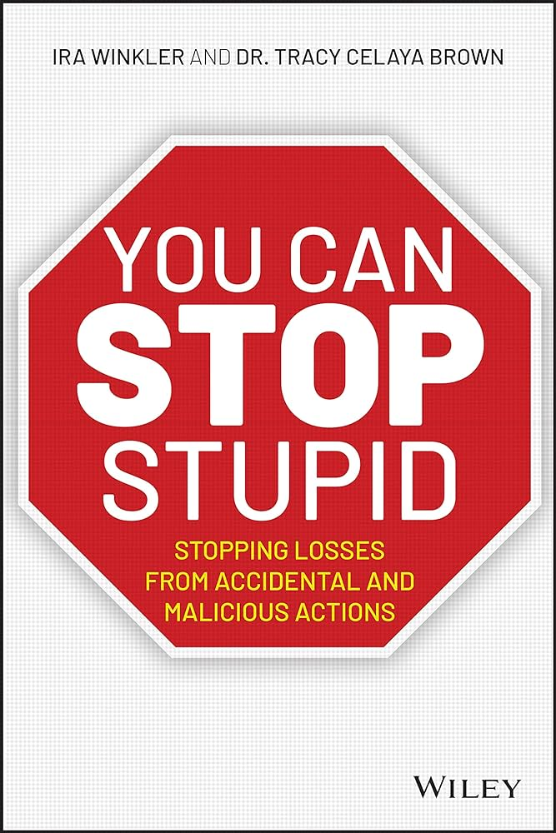
Conclusion
“[…] I understood that we needed to stop just being specialists in one discipline and that it was important to listen to what others had to tell us: biologists, psychologists, sociologists, cats, and others.“ – Luc Julia, p 180.³
Changing the narrative
Stop siloing the field
Shall we talk more about augmented intelligence?
Tools enhancing the creator’s intelligence?
Too deep rooted in the language.
Technology is as dangerous as we intend to use it. → Change Humans [as much as one can]
if it looks like a dog…
Computer and information science, “cyber” etc, etc.
Industrial military complex…
Overspecializing = feeling of control to a closed group, realizing control is Overrated

Slide 9
Thank you
Océane I.P. Van Geluwe​
EI&C Nuclear Safety Qualification, Tihange
VIE Business France at AKKODIS Belgium
+33 7-45-07-77-75
ovangeluwe@gmail.com

Slide 10
Sources
J. McCarthy, D et al. A PROPOSAL FOR THE DARTMOUTH SUMMER RESEARCH PROJECT ON ARTIFICIAL INTELLIGENCE, August 31, 1955. Link.
Klondike. AI history: the Dartmouth Conference. Link.
L. Julia. L’intelligence artificielle n’existe pas. Editions First. p. 123. 2019.
Nader K, et al. Public understanding of artificial intelligence through entertainment media. AI Soc. 2022 Apr 2:1-14. doi: 10.1007/s00146-022-01427-w.
Grandpierre, G. “L’intelligence artificielle va-t-elle changer nos vies?” L’Union. Link.
Winkler I and Brown You CAN Stop Stupid: Stopping Losses from Accidental and Malicious Actions. Pp. 368. 2020. ISBN-10 ‏ : ‎ 1119621984
Even-Dar E. et al. Action Elimination and Stopping Conditions for the Multi-Armed Bandit and Reinforcement Learning Problems. Journal of machine learning research, 2006
Longpre, S. et al. “Lethal autonomous weapons systems & artificial intelligence: Trends, challenges, and policies.” Ed. McDermott, K. MIT Science Policy Review, vol. 3, pg. 47-56 August 29, 2022.
Xu H., et al. Robustness and Regularization of Support Vector Machines.– Journal of machine learning research, 2009;
Mannor S. and JN Tsitsiklis. The sample complexity of exploration in the multi-armed bandit problem Journal of Machine Learning Research, 2009.
Tessler C. et al. Reward constrained policy optimization. - arXiv preprint arXiv:1805.11074, 2018
Tessler C et al. A deep hierarchical approach to lifelong learning in Minecraft - Proceedings of the AAAI conference on artificial …, 2017.
Zahavy T. et al. Graying the black box: Understanding dqns - International conference on machine learning, 2016

